Slide 1



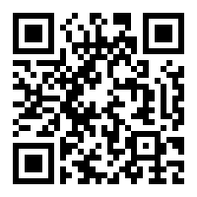
MISSION
To achieve and sustain the most resilient and mentally fit Reserve force in the Nation. We will accomplish this by facilitating mental health services for Soldiers and family members who need them; by assisting operational leadership through command consultation; by preserving unit cohesion through traumatic event management; and with the development of enduring partnerships with sister organizations. The result will be a resilient, mentally fit, and ready Army Reserve
Army Reserve
Psychological Health Program
USAR Primary Behavioral Health
Resource for Soldiers,
Family members, and
Commanders
Services:
Resource referrals
Command consultation
Case management
Psychoeducation
Traumatic event management
Services:
Command Consultation
Case Management
Referrals for care
Staff Assistance
Postvention
VISION
To be the primary behavioral health resource for the Army Reserve.
www.usar.army.mil/PHP
Victory in Health!

Slide 2

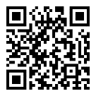
WHO WE ARE
Our team is made up of behavioral health clinicians and nurse case managers who are assigned by Readiness Division. Scan the QR code or visit link below for the most up to date points of contacts.
WHAT WE DO
Soldier Assistance:
Assess Soldier BH needs.
Connect to suited BH resources/support based off their needs.
Assist with BH profile/MEB process questions and connect to appropriate POC’s.
Command Consultation:
Serve as SME’s on BH scenarios, processes, regulations, evaluations, etc.
Discuss options and resources to assist Soldier with BH needs.
Case Management:
Serve as a bridge between Soldier, Command, and other programs.
Unit Support & Education:
Train units on mental health issues and resources
Support units in managing traumatic events in coordination with Command, Chaplains, and other Army programs.
HOW TO REACH US
www.usar.army.mil/PHP
General Program Email:
usarmy.usarc.usarc-hq.mbx. psychological-health-program @army.mil
AUTHORITY
The Army Reserve Psychological Health Program is administered through the Office of the Surgeon, United States Army Reserve Command, Fort Bragg, NC.

