Slide 1
USARC FOUNDATIONAL READINESS DAY: The Value of Life A Life Worth Living
14 April 2023

Slide 2
KEY POINTS: A Life Worth Living
The Value of Life and a Life Worth Living
The value of a strong spiritual core
The importance of connection with ourselves, our work and with others
The impact of leadership on a life worth living
Notes:
These are the three topics we will be looking at today.
As we consider the value of life and building a life worth living, we will discuss the value of centering that life on a strong spiritual core. Next, we will underscore the vital importance of the concept of connection, not just with other people but ourselves, and out work. Hoping to see all the parts of our life as a unified whole, not fragments scattered across time and space. Finally, we will consider ways that leaders can help other develop that life worth living. For the purpose of this discussion, we are not necessarily talking about leaders in terms of positions, i.e. “The Boss” but leaders in terms of influence. And in that sense, everyone can be a leader…both here in the work environment but at home, and in all your areas of life. So strong spiritual core, connection with ourselves, work, and others, leadership influence to build a life worth living.

Slide 3
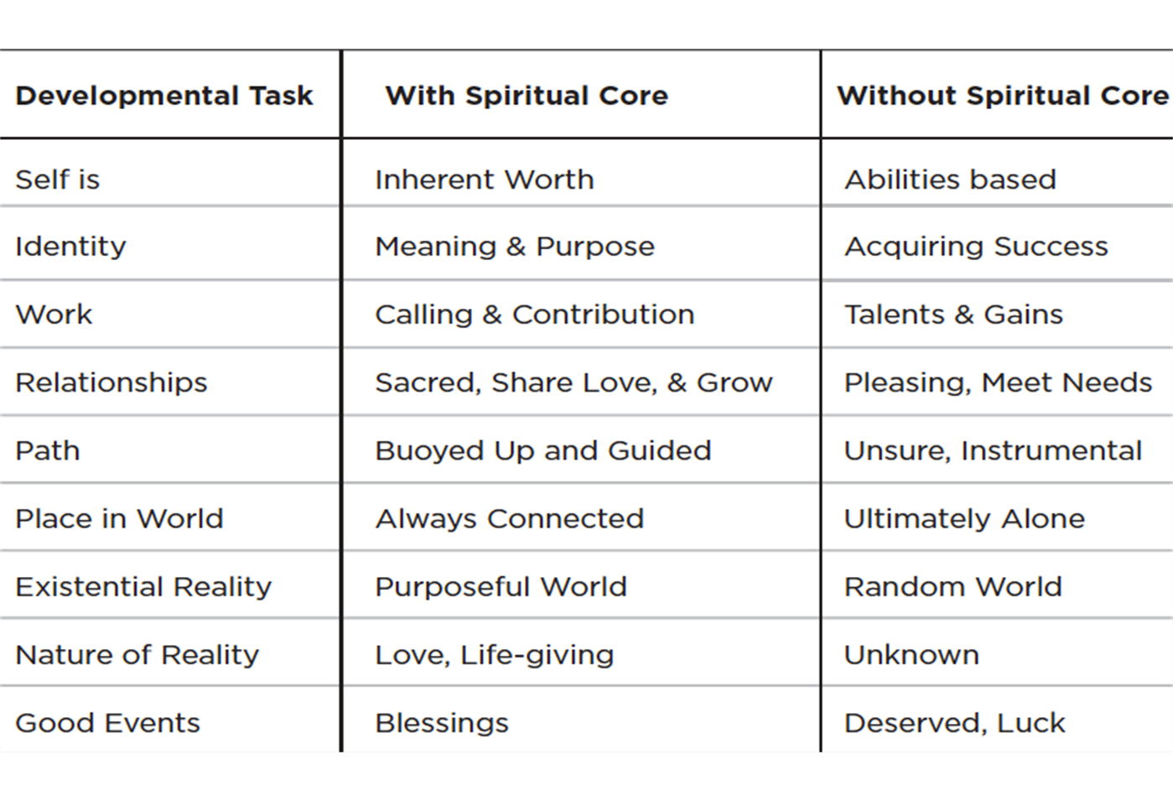
The Value of Life and a Life Worth Living
Notes:
Does anything surprise you on this chart. If you have a strong spiritual core the chart states that the view of reality if purposeful, love and life giving. What happens with spiritual people when they experience life as “Not” these things…like in times of tragedy and disaster?
As you review the experience without a strong spiritual core, what is the danger of basing your reality in your abilities, talents, and people-pleasing?
Dr. Lisa Miller, foremost expert on the Science of Spirituality describes the experience of life with and without a spiritual core, See excerpt from her finding below:
(Regarding a study following a cohort of youth from age 18 through 24.
They also found that the 85 percent of the sample who were not spiritual had over tenfold the national rate of risk for sociopathy…. Socialized in a culture that equated their worth with how fat or skinny they were, or whether they got an A or a B on the last exam, they had no unconditional love or sense of connection as a bedrock…. They’d grown up lonely and disconnected, using others and being used in an achievement game….
The fifteen percent who do consider themselves spiritual are not experiencing the elevated, through-the-roof anxiety, depression, and substance abuse of the rest of the cohort…
The cross-sectional leg of the data didn’t prove that spirituality causes better mental health. But, once again, it showed that spirituality strongly correlates with a reduced rate of suffering. That if you are spiritual, you are protected and inured from otherwise increased risk… These young adults, who’d been spiritual as eighteen-year-olds and had maintained or renewed their spiritual life in their twenties, were much less likely to be depressed, much less likely to abuse substances, and more likely to be in healthy relationships and to join organizations or communities of contribution. A strong spiritual core gave these young people a whole different life. Excerpted from the book THE AWAKENED BRAIN by Lisa Miller. Copyright © 2021
A Large part of building the Spiritual Core rests in the concept of Connection, See the Developmental Task “Place in World” With a Spiritual Core, life is experienced in connection. We are going to look at this idea of Connection: with ourselves, our work, and others.

Slide 4
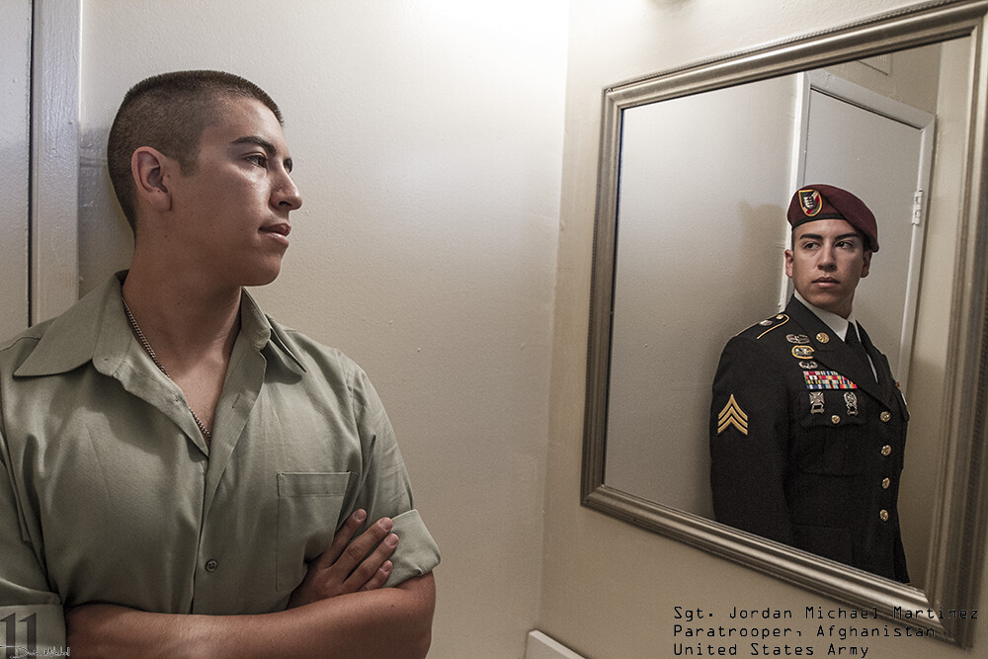
The Nature of Self
The Value of Life and a Life Worth Living
“Because true belonging only happens when we present our authentic, imperfect selves to the world, our sense of belonging can never be greater than our level of self-acceptance.”
Brené Brown
Notes:
The mission our national leaders give us are typically based on defending the lives of others, which assumes the value of life. But have you ever considered your own life?
Consider for yourself, Does your life have meaning and value. Since we know out time on earth is limited what gives purpose to the time we have? You may recognize this type of photo from Social Media. Service Members were photographed with the mirror reflecting what others see, while the person in mirror may have looked very different. When you look in the mirror is there alignment between what you see and what there is inside?
Discussion:
Have you ever spent time contemplating the nature of “the self”? (answers could include, church, therapy, psychology classes or reading, philosophy etc) Do your thoughts or conclusion inform your day-to-day life? If so, how? If not, why not?
What has been said through the ages about the value of a person? (Scriptures, History, Philosophies, Spirituality)
Are people inherently valuable or is their value based in what they can do, their abilities or the production value? Why?
Describe you core identity and what gives you self-worth.

Slide 5
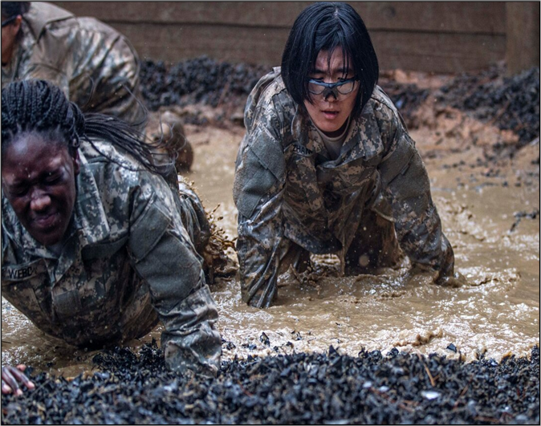
The Nature of Work
The Value of Life and a Life Worth Living
“Your work is going to fill a large part of your life, and the only way to be truly satisfied is to do what you believe is great work. And the only way to do great work is to love what you do.”
- Steve Jobs
Notes:
FACILITATOR: It is highly likely that most people spend most of their lives “at work” more hours in the day then almost anything. And then you consider the supporting things outside of work like a commute or education etc. You are a member of the US Army, whose job it is to fight and win its nations wars. Why did you choose this as your profession (Military and Civilians) What keeps you doing it day after day when those days are tough? At the most basic level, yes…we work because we want to provide for our basic needs, and for our families. But you could have chosen a lot of ways to do that…why the Army instead of say…retail, or banking? Why did you choose the MOS or Branch you did? As civilians, of you had a previous uniformed career why stay in the Army? If you were never in uniform why choose the Army? Think of practical reasons, and look for those deeper ideas, that gives value to you work beyond a paycheck.
Discussion:
As you look at the picture of these Soldiers at Basic Training, Do you agree with Steve Jobs’ quote above? Why or why not? Do you think they are loving what they are doing right now?
Does work bring value? Does achievement bring value? What happens when you retire or can no longer work?
How are your faith and values reflected in the work you do for the Army? Not just in terms of the tasks you accomplish but working with people and the mission of the organization?

Slide 6
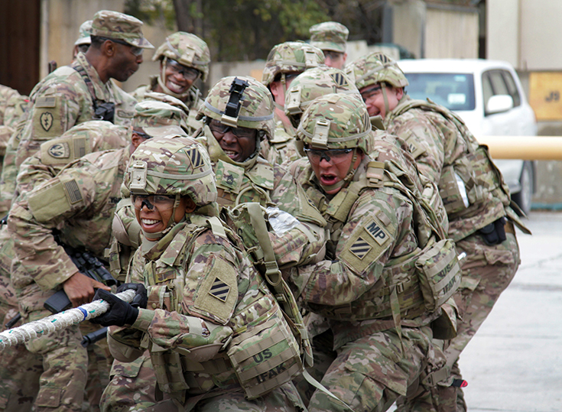
The Nature of Others
The Value of Life and a Life Worth Living
“We need Joy as we need air. We need Love as we need water. We need each other as we need the earth we share.”
-Maya Angelou
Notes:
FACILITATOR: Think of this very famous poem by John Donne and compare with Maya Angelou’s quote.
Many are familiar with the 1st and last line of 'No Man is an Island’ by John Donne
“No man is an island entire of itself; every man is a piece of the continent, a part of the main; if a clod be washed away by the sea, Europe is the less, as well as if a promontory were, as well as any manner of thy friends or of thine own were; any man's death diminishes me, because I am involved in mankind. And therefore never send to know for whom the bell tolls; it tolls for thee. Why is it when the bell tolls for someone else…it is also tolling for you?”
What are your significant relationships? Who are the important low intensity connections? (these are people with whom we regularly interact that are not in our work/social worlds…for example your bartender, the people you stand with at the bus stop, your barista at the coffee shop, your barber or hair stylist.) Research shows these are very important, why do you think that is?
Leaders, people of influence, and people with authority can assist in developing the spiritual core of those in their charge (or sphere of influence). We will know look at how leaders can be involved in building the spiritual fitness (spiritual core)

Slide 7
Spiritual Readiness Conversations for Leaders
Leader Question | If needs further development…
How would you answer the question, “Who Am I?” | After reflection, a person writes a self-narrative, who they see themselves to be.
Do you think your life has meaning? If so, where does that meaning coming from? | Talk with family, friends, mentors, chaplains intentionally about “the meaning of life.”
What aspects of my life can I control and what cant I control? | Meditation on coping with things out of our control.
How do I typically respond when experiencing adversity? | Engage resources and agencies that provide coping tools and strategies.
To what or who are you most connected? | Plan to regularly reach out to people who are important to you and who care about you.
What connections cause significant distress? | Consider healthy “disconnection” strategy. Journal about forgiveness.
WHAT TO AVOID IN SPIRITUAL DISCUSSIONS!
Do NOT let the conversation turn into an argument about spiritual beliefs or religious persuasion.
Do NOT use your position or influence to assert one spiritual or religious practice over another person. Everyone has the responsibility and power over their own spiritual life.
Do NOT be afraid to share your own journey and what has helped you in life to get where you are.
Do NOT monopolize the conversation. Let your Soldier’s feel open and free to talk about their own personal beliefs and practices.
Do NOT let you Soldier’s spiritual fitness stay low. See FM 7-22 Chapter 10 for more guidance.
Notes:
Leader’s can help build the holistic health and fitness of their force. In the same way you have Master Fitness Trainers, you have Chaplains to help build spiritual fitness. The best thing leaders can do is to support Soldiers on their Spiritual journey, get Soldiers thinking about these deep questions, that undergird lives worth living. We are not looking for right and wrong, but the process, the journey the discovery, helping to develop awareness. Leaders could be very transparent and prompt others.
For example, at the beginning of a staff meeting you could budget time based on the size of the meeting and start with an “ice breaker, or “team builder” e.g.
Leader: “How do typically respond when experiencing adversity? I’ll go first, normally when experiencing adversity, I will take a long walk with my spouse. It helps me to take a break from what’s happening, and my spouse is a great listener” Person 1, “I never really thought about it, can you come back to me?” Leader: “Sure, Person 2, what do you do in the face of adversity?” Person 2, “I don’t normally go to church, but during tough times I feel a lot of comfort in attending, so I make it a point to go then.” Person 3 “I am going through a tough time right now, so I started to see a therapist” Person 4 “I make sure I keep up with my meditation, prayer, and I take a yoga class once a week.” Person 1 “Oh I have something…When I am going through a tough time, I find it really helps to go to the gym, I even take a kick boxing class, which helps manage stress, does that count?” Leader: “Of course it does, sounds very healthy, in more ways than one!”
Does anyone notice the theme of connection that runs through everyone’s response?

Slide 8
KEY POINTS: A Life Worth Living
The Value of Life and a Life Worth Living
The value of a strong spiritual core.
Identify and develop your Spiritual Core.
The value of connection with ourselves, our work and with others.
Assess and nurture your connection to all areas in your life.
The impact of leadership on a life worth living.
Measure and build your positive influence on others.
Notes:
Let’s review our Key Points for todays discussion.

