Slide 1

USARC FOUNDATIONAL READINESS DAY:
The Value of Life
A Life Worth Living
02 March 2022

Slide 2

KEY POINTS
The Value of Life and a Life Worth Living
Your life has value and purpose.
You are a critical member of our Army Reserve team.
You matter to me, your leaders, family, and friends.

Slide 3
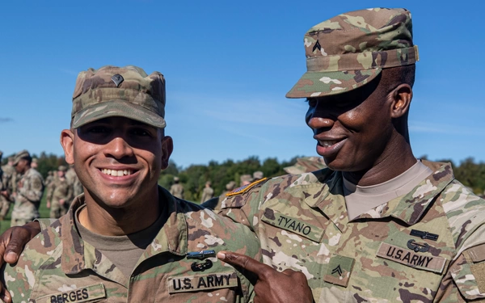
THE PROFESSIONAL SOLDIER
The Value of Life and a Life Worth Living
An American Professional Soldier is an expert, a volunteer certified in the Profession of Arms, bonded with comrades in a shared identity and culture of sacrifice and service to the nation and the Constitution, who adheres to the highest ethical standards and is a steward of the future of the Army profession.
Profession of Arms White Paper 2010
Notes:
Photo from DVIDS

Slide 4
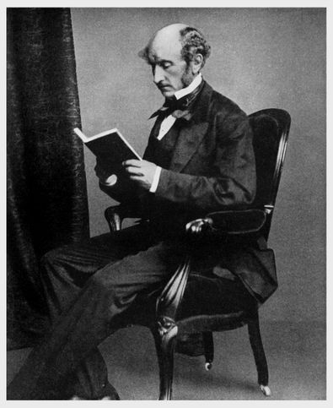
The Value of Life and a Life Worth Living
Utilitarianism “According to the Greatest Happiness Principle…the ultimate end…is an existence exempt as far as possible from pain and as rich as possible in enjoyments, both in point of quantity and quality…this being, according to utilitarian opinion the end of human action…an existence such as has been described might be to the greatest extent possible secured to all mankind; and not to them only but, so far as the nature of things admit to the whole sentient creation.”
  John Stuart Mill, Utilitarianism
Notes:
Photo of Jonathan Stuart Mill

Slide 5
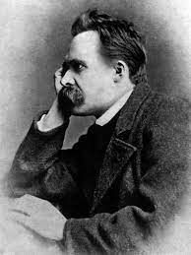
The Value of Life and a Life Worth Living
Nietzsche “What is good? Whatever augments the feeling of power, the will to power, power itself, in man. What is evil? Whatever springs from weakness.
What is happiness? The feeling that power increases—that resistance is overcome.”
Friedreich Nietzsche The Antichrist
Notes:
Friedreich Nietzsche

Slide 6
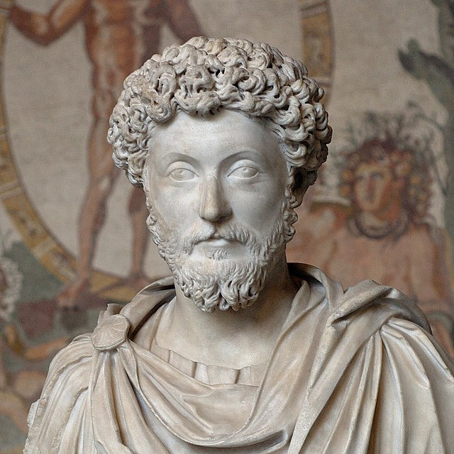
The Value of Life and a Life Worth Living
Stoicism “What then is it that is worth one’s while to be concerned for? Why nothing but this: to bear an honest mind, act for the good of society, to deceive nobody, to welcome everything that happens as necessary and familiar…put yourself into the hands of fate, and let her spin you out what fortune she pleases”
Marcus Aurelius’ Meditations
Notes:
Marcus Aurelius, Roman Emperor

Slide 7
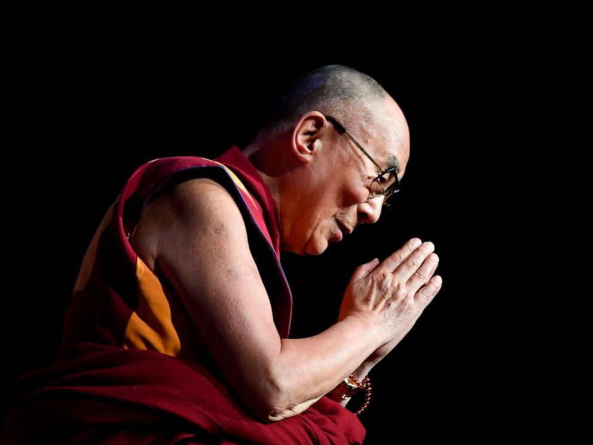
The Value of Life and a Life Worth Living
Buddhism “Living in society, we must share the suffering of our fellow citizens and practice compassion and tolerance not only toward our loved ones but also toward our enemies. This is the test of our moral strength. We must set an example by our own practice. We must live by the same high standards of integrity we seek to convey with others. The ultimate purpose is to serve and benefit the world.”
Dalai Lama, How to See Yourself as You Really Are
Notes:
Photo of Dalai Lama

Slide 8
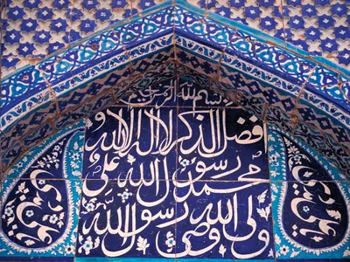
The Value of Life and a Life Worth Living
Islam Only when human beings worship their God by submitting to His religious law can they have peace and harmony in their lives and the hope for heaven, just like the universe runs in harmony by submitting to the physical laws set by its Lord. When you remove the hope of heaven, you remove the ultimate value and purpose of life. Otherwise, what difference would it really make whether we live a life of virtue or vice? Everyone’s fate would be the same anyway.
Imam Kamil Mufti, Meaning of Life in Islam
Notes:
Photo of Arabic Calligraphy depicting the Shahada “There is no god but God; Muhammad is the Prophet of God.”

Slide 9
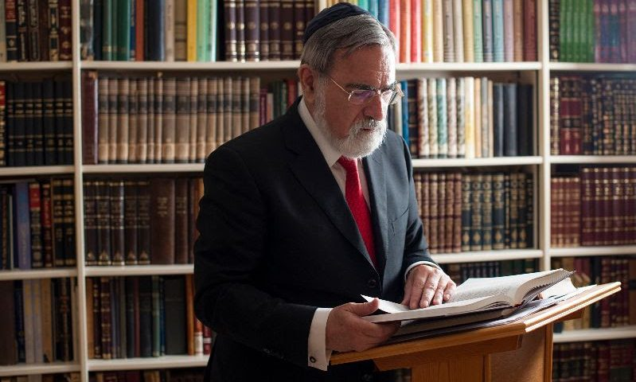
The Value of Life and a Life Worth Living
Judaism “Kohelet [The Teacher] finds life short. The prospect of death threatens to rob him of all happiness, until he realises [sic] that mortality is the very condition of our happiness. Because life is short, every moment is precious. That is the knowledge most of us are only taught through pain or crisis or loss. Work, love, life itself: these are the sources of joy…Happiness lies in being, not in having.”
Rabbi Lord Sachs, Happiness is to be found in Being, Not in Having
Notes:
Photo of Rabbi Lord Jonathan Sacks.

Slide 10
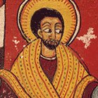
The Value of Life and a Life Worth Living
Christianity “If anyone wants to come after Me, he must deny himself, take up his cross daily, and follow Me. For whoever wants to save his life will lose it, but whoever loses his life for My sake, this is the one who will save it. For what good does it do a person if he gains the whole world, but loses or forfeits himself?
Luke 9:23-25
Notes:
An 18th-century Ethiopian image of Jesus

Slide 11
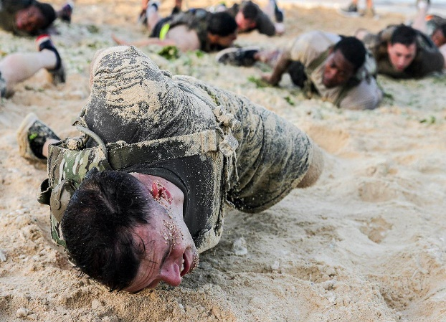

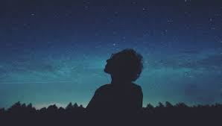
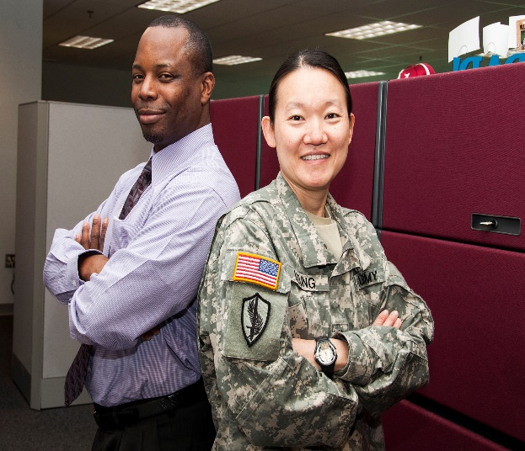
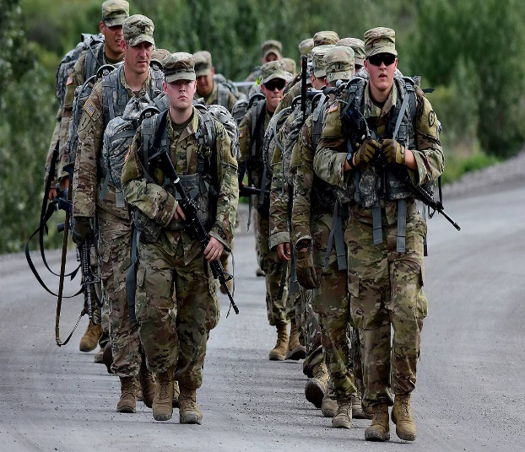
The Value of Life
VALUE: noun
relative worth, merit, or importance.
Why do we have value?
What is the source of my value?
Why do other people have value?
How can I increase my value?
How does our value and the value of others make a difference in our actions? That is how do we treat others?
Notes:
Photo of Rabbi Lord Jonathan Sacks.

Slide 12
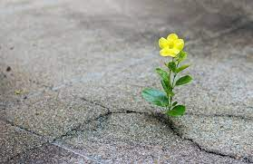
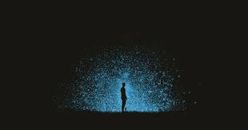
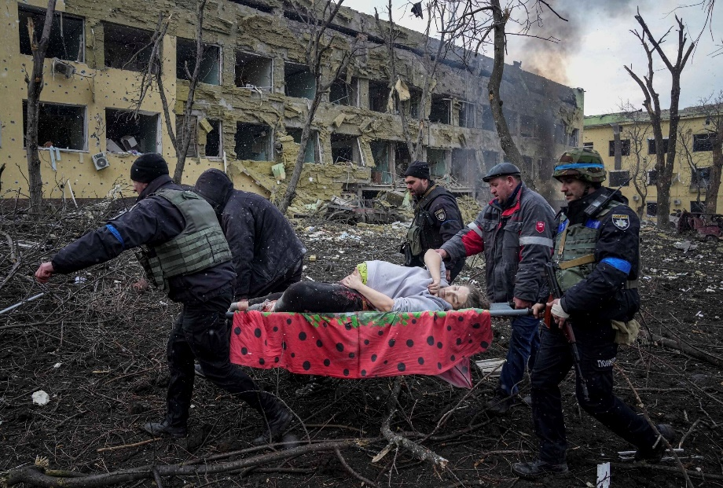
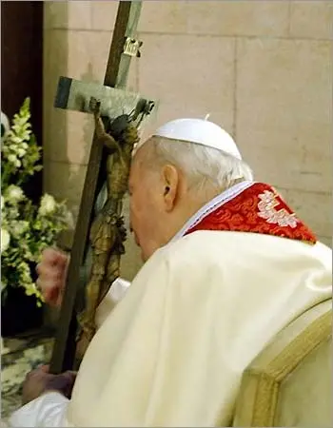
A Life Worth Living
What are your sources of hope?
    Have you ever lost hope?
    Did you get it back? If so, how?
How can pain, suffering, and grief contribute to a life worth living?
NOTE: often positive impacts can ONLY be seen in retrospect, after time has elapsed and care and healing has taken place
Notes:
Lower photos: Bombing of Maternity Hospital in Ukraine mother and baby both died. Pope John Paul on Good Friday (his last Good Friday alive). Good Friday is when Christians commemorate the crucifixion of Jesus.

Slide 13
Strategy for A Life Worth Living
My Current Life
My Life Worth Living
Is there a Gap?
Who am I? What do I believe? How have I gotten to where I am? How do I spend my time, talent and treasure? Who are the important people in my life? What gives me joy, contentment? What cause me pain? What can I control? What can’t I control?
What is worthy for me to spend my life on? What do I want to be known for? What do I want my obituary to say about me? What is a “Good Life” and “A Life Worth Living” look like for me?
Do my current priorities support a life worth living? Are there people, things, habits, keeping me from living a meaningful life? My best life? If so, can I let them go? Who can help orient my life for significance and meaning? Am I a person of hope?
Notes:
Photo of Rabbi Lord Jonathan Sacks.

Slide 14
KEY POINTS
The Value of Life and a Life Worth Living
Your life has value and purpose.
Can you identify why your life has value or meaning?
You are a critical member of our
Army Reserve team.
As part of a team, how do you value and treat your teammates?
You matter to me, your leaders, family, and friends.
How does being valued, impact your actions and beliefs?

