Slide 1
“Every Chaplain Corps Member A Recruiter”
(ECAR)
“A Sacred Calling to Serve God and Country”
(15 FEB 2022, CHBOLC Version)
Questions: occh-recruitingandaccessions@army.mil
Notes:
(Graphics updated with 2020 Brand Book Graphics)
SLIDE NOTES:
Welcome. Intro yourself. Remind them to silence cell phone and that you will take breaks, then don’t forget to actually take them. Have someone remind you! (Suggested: 10-15 min breaks per 45-50 mins training.)
Explain timeline and agenda (see next slide).
Intro statement: We are here today because we need your help to recruit tomorrow’s Chaplains today! And we need your help to influence who becomes Religious Affairs Specialists and Directors of Religious Education. This training is part of the Chief of Chaplains #1 Line of Effort: recruiting.
These slides are available on an on line portal, to be discussed later. As you can see at the bottom of this first slide there is also a generic email address which you can use to contact the Dept. of the Chief of Chaplains (DACH)-Recruiting (REC) office directly. It will be on the slide at the end as well.
ADMIN NOTES:
This slide deck will be updated periodically. Check the portal to ensure you have the latest version. Date is on this slide above the DACH-REC email.
This training fulfills a Chief of Chaplain’s training priority and is included in the Chief’s FY2020 Training & Leader Development Guidance (SEP19).
This version of ECAR training is meant to be used at a UMT Training 90 minutes or longer, or for self-training.
The brief is naturally going to lean towards the effort to recruit chaplains, but it is intended to include elements of how we in the Corps can also influence those who become Religious Affairs Specialists and Directors of Religious Education as well. It is directed towards the Corps at large, all at different levels. To that end, terms are often spelled out and few things are assumed.
BRIEFING 101: The script on each slide is suggested as well as some ADMIN notes. Please DO NOT just read the side to the audience. Make it your own. Don’t read everything on every slide! Let people read themselves as you highlight things.
It is meant to be interactive. It has been designed to encourage participation from all. Questions are designed to encourage breaking your audience into smaller groups to provide opportunities for everyone to share. If training time is short, you can simply call on a few to share with the group as a whole for each “participation slide” rather than breaking the audience down into smaller groups.
This training is to be “Total Army” in that all three Compos are emphasized. We need to cast the vision that we are recruiting for all three COMPOS. One Army, one fight!
Hidden slides: you will see that some slides are hidden because they contain a lot of extra information which is helpful to have access to, but isn’t necessary for a brief which intends to get a few points across well. They are here for your information. You may unhide them if you wish. Or just tell people they can download the slide deck to have access to all hidden slides with the details that go with the main points you are making.
Ultimate End State: Vision has been cast and CHC members are motivated to start engaging immediately with potential applicants about serving in the Chaplain Corps.
Finally: Feel free to personalize presentation. These slides are not meant to constrict you, but to help you meet the intent of the Chief’s training priority.

Slide 2
Word for the Day:

Slide 3
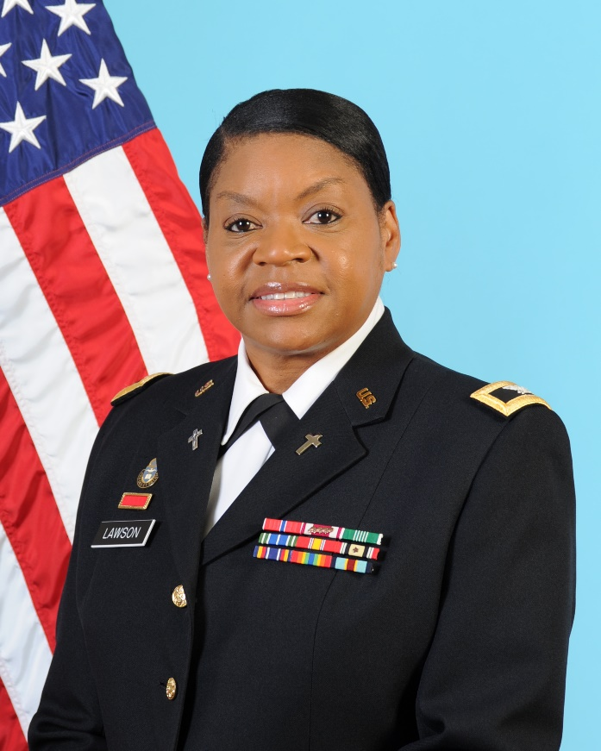
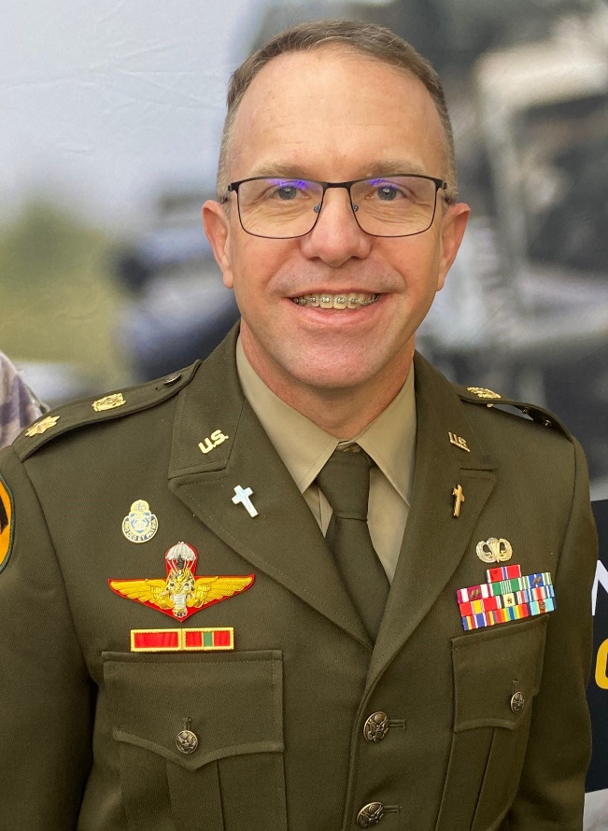
DACH- REC Team
(Recruiting & Accessions)
CH (COL) Monica Lawson DIV Chief Cell: 703-819-3863 monica.r.lawson.mil@army.mil
CH (MAJ) Alf Matthews Accessions Officer Cell: 571-334-4365 alfred.e.matthews2.mil@army.mil

Slide 4
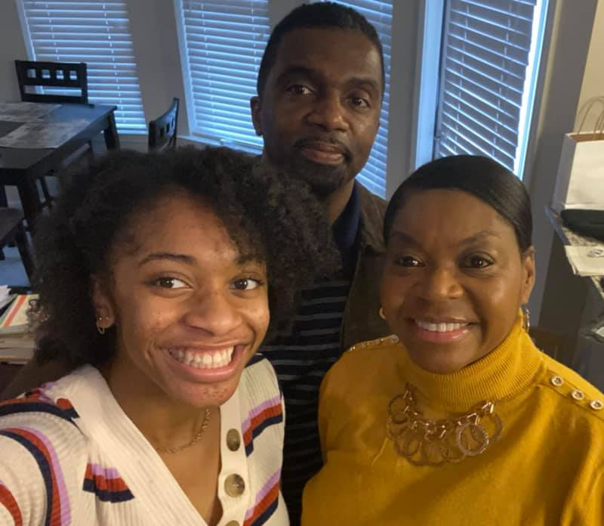
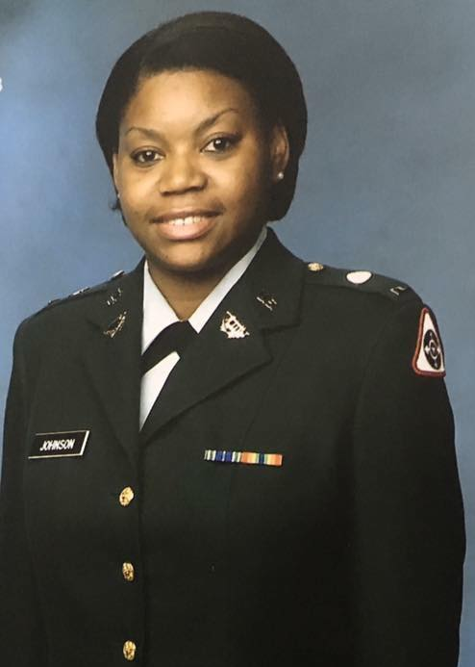
Before I was a Chaplain….
Team Lawson
I was a Chaplain Candidate!
And before that…
PFC Johnson 1988
Victory Tower CHOBC 1999

Slide 5
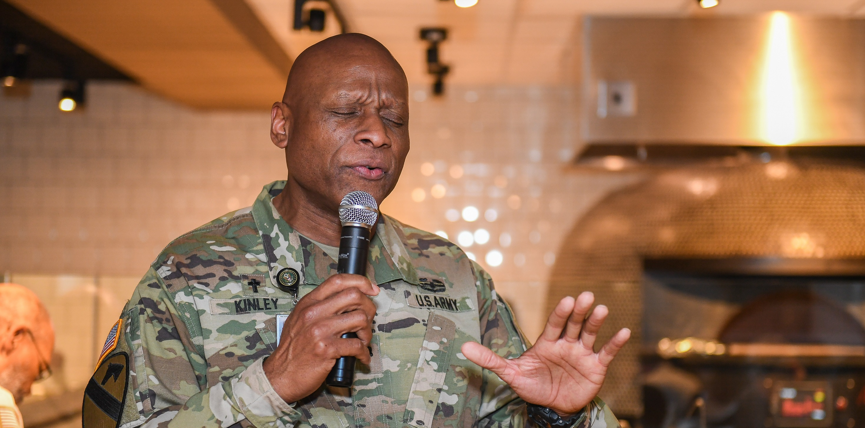
Our Goal Today
To motivate & equip YOU to help
with our recruiting mission!!!
Let us begin by looking to the past….
Notes:
SLIDE NOTES
First note that in the lower left you’ll see on every slide one of the easiest ways to put someone in touch with a Chaplain Recruiter: to text “chaplain” to “goarmy” for COMPO 1 & 3 and 1-800-GO-GUARD for COMPO 2, ARNG. These are some the basic things I want everyone here to walk away with memorized!
On the right you’ll see the link to our portal where these slides and other digital brochures and handouts are available. It is a non-CAC card site making access easy. You can memorize this if you are high-speed! Or take a picture! NOTE: you may or may/not have a certificate error when accessing from a non-government network. If you get this, just authorize it, the site is safe and proceed to the ECAR site.
ADMIN NOTES
- The assumption is that GOOD CHs and GOOD NCOs want to steward the profession of arms, in particular our CH Corps. We can play a vital part in that by helping find tomorrows’ CHs and RASs today!

Slide 6
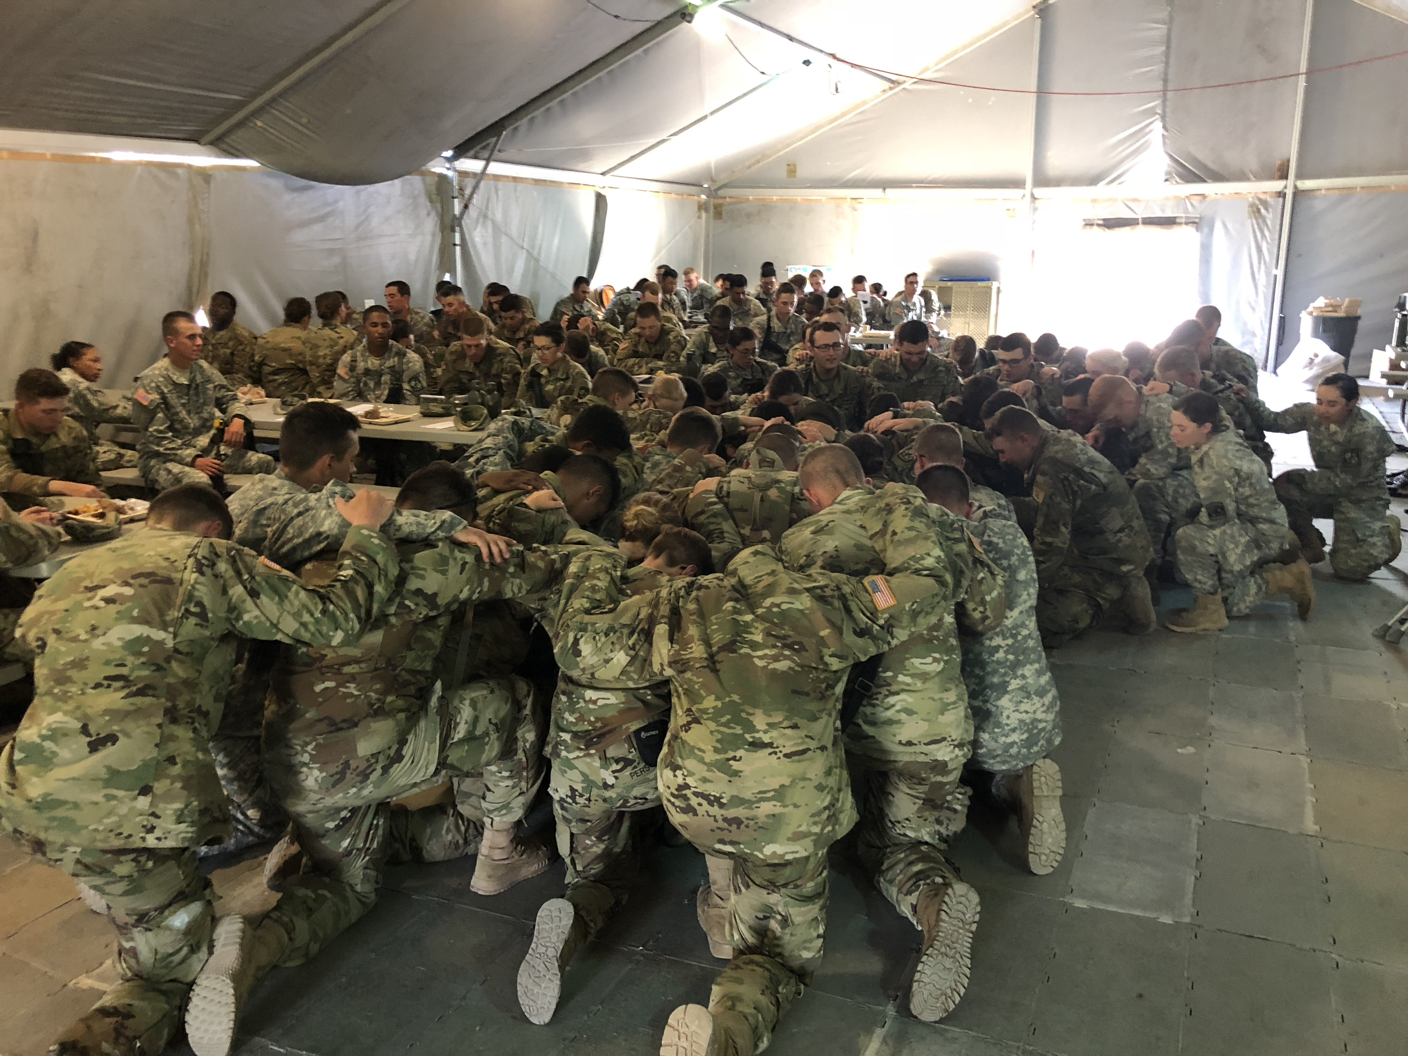
“Share your story!”
Share why you joined the Chaplain Corps.
Notes:
SLIDE NOTES:
Why did you join the Chaplain Corps? Speak from your foxhole, CH, RAS, DRE, etc. If you’re here with your spouse, feel free to tell your story in tandem.
ADMIN NOTES:
You can do this in smaller groups of 2-3 if conducting a longer training event, or just ask for a few to share from the floor directly if time is short.
If using groups:
Give them 2 minutes each, keep track of time, and call out “switch” to ensure everyone gets a chance to share.
This exercise should take 10 minutes. It is important because it reminds UMTs why they joined and also shows them we all have a story to tell and that we CAN tell it, even if we only have a few minutes.
Encourage groups to have at least one 56A and56M in each group.
If spouses are present, encourage them to tell their story as a family rather than individually.
After all share within the group, ask a few to share their stories for the entire group. I suggest you pick these people to share, rather than asking for volunteers, to ensure a diverse group getting a wide range of stories.

Slide 7
We need Religious Leaders who KNOW their identity and live it out via their Calling!
Called Vs. Career
Here is one comparison:
A career ends at retirement; a CALLING never ends until you die.
A career ends with lots of awards and recognitions; a CALLING ends with rewards that may never been seen this side of heaven.
- English Author: Os Guinness
Notes:
SLIDE NOTES:
Now, going back to what we opened up our training, with the Ice Breaker: Telling our story!
No one can argue with “your story!” It’s like your personal testimony of faith.
But here are some things to keep in mind to help you tell your story well.
By Telling your Army Story you generate Referrals
While each story is personal, its message is universal in its impact on the audience you are telling it too.
Allows the opportunity to share your own Call and impart vision.
Establishes trust and credibility.
Gives the individual a chance to see the Army through your eyes.
ADMIN NOTES:
Incentives:
COMPO 1, RA: Active Duty options has Finder’s Keepers and Buddy System. Details on hidden slides. BLUF: it’s possible to recruit to a particular duty station or for two new applicants to be assigned to the same duty station. Contact Accessions Officer in the PER for the official memo and all the details.
COMPO 2, ARNG: has incentives as well both accessions as well as service loan repayment options. See hidden slide for more details.
COMPO 3, USAR’s incentive program: loan repayment, is on a hidden slide which you can see if you download these slides.
For all, have your interested lead talk to a recruiter for all the details.

Slide 8
1
Sacred Mission
Care for Soldiers & Families
Chaplain Recruiting
By the Numbers
One Million+
U.S. Army Soldiers
2
Years of Professional Work Experience (PWE) Needed
(35% of AD CH Accessions have a PWE Waiver)
5000+
Total Army Chaplains Corps
5 Yr Plan
To increase RA CH Corps to 110% end strength
186
DoD Endorsing Agencies
10 to 1
Ratio of Contacts (leads) to produce 1 Contract (newly accessioned CH)
C4 Residential Course was temporarily eliminated to help keep CH (CPTs) in units. JUL 21 it was turned back on!
72 hour
Masters degree Required
< 1%
Of Americans meet the age and educational requirements to become an Army Chaplain.
**This does NOT take into account Height/Weight, PWE, or moral disqualifications!**
54
Average Age of a Senior Pastor in the U.S.
#1 Reason
newly accessioned CHs join: The influence of a personal relationship/contact!
0
Fulltime ARNG CH Recruiters
71% Of Youth do not Meet Qualifications to Serve in the U.S. Military!
544 Accessions
Total Army Chaplain Corps Recruiting Mission FY2022
77%
Current ARNG CH Strength
Notes:
SLIDE NOTES:
Here is a 2nd reason. Take a look at these numbers.
Please look this slide over. What jumps out at you?
ADMIN NOTES:
Allow responses to flow. Some things to be sure to mention:
According to Rand Corporation research done for the Army Chaplaincy in 2019, less than 1% of Americans meet the educational and age requirements to become Chaplains. It does NOT take into account their height/weight, their professional work experience needed (2 years) or whether or not they have any moral/legal violations which would preclude their serving as a Chaplain.
It takes a Chaplain Recruiter, on average, talking to 10 good leads to produce 1 “contract” who will join the Army Chaplaincy.
Open Chaplain slots is down from the 60+ we were at earlier this year, but that is due to the temporary elimination of the C4 Residential course. We need to plus up the force so when the course is started again in a few years we can send CH’s to C4 and not have unfilled slots.
BIGGEST point to mention: the #1 reason newly accessed Chaplains report that they joined the Army is because of a personal contact or relationship. “Recruiter” is way down on the list.
******We, the rank and file of the Chaplain Corps have the largest influence on whether our religious leader colleagues will join the Army or not.
NOTE: Less than 25% of our RA Chaplains come from our CC program either RA or ARNG. Most come from civilian pastorate direct, about 30%. Rest come from RA and ARNG CH’s who were not CCs or direct prior service Soldiers who come back in straight as a RA CH.

Slide 9
Be Encouraged:
This is a mission only God can accomplish!
God has more invested in the Chaplaincy then we ever will!
May our prayer be: “Lord lead us to those you want to be in the Corps!”
(A CH Recruiter’s heart and prayer)
Notes:
SLIDE NOTES:
After looking at the current status, and at times such daunting numbers, let us take courage: This is something only God can do!
Let’s remember that God has more invested in the Chaplaincy than we ever will!
Let’s not do ECAR without praying! We don’t just want slots filled. We want the RIGHT people in those slots! God knows who they are! Let’s ask God to lead them to us, and us to them!
All of these statements were shared by an experience Chaplain recruiter with years of experience! Amen!

Slide 10
More Detail on How to Tell Your Story
When Telling Your Army Story keep these in mind:
Being an Army Chaplain is a Sacred Call to Serve God and Country.
The reasons and circumstances why you joined the Chaplaincy (your calling).
Explain the uniqueness of the Chaplain’s role in the Army (your mandate: the Free Exercise of Religion.)
Ministry opportunities at different command levels (your influence).
Your experience as a Chaplain and as a Leader (your leadership).
Unique Ministry in Specialty Roles (your personal and professional development).
Duty Assignments and Deployment Opportunities (your global mission)
The Army Life - GI BILL, BAH, Medical, 401K Retirement
RA (Active Duty) Incentive Program: Finder’s Keepers & Buddy System * (Contact Accessions Officer.)
ARNG Incentive Program: $10k Accessions bonus, up to $80k loan repayment. *
USAR Incentive Program for $20-40K loan repayment for years of service commitments. *
**Minister to them personnally! Offer to PRAY for them as they think through this ministry!
Notes:
SLIDE NOTES:
Now, going back to what we opened up our training, with the Ice Breaker: Telling our story!
No one can argue with “your story!” It’s like your personal testimony of faith.
But here are some things to keep in mind to help you tell your story well.
By Telling your Army Story you generate Referrals
While each story is personal, its message is universal in its impact on the audience you are telling it too.
Allows the opportunity to share your own Call and impart vision.
Establishes trust and credibility.
Gives the individual a chance to see the Army through your eyes.
ADMIN NOTES:
Incentives:
COMPO 1, RA: Active Duty options has Finder’s Keepers and Buddy System. BLUF: it’s possible to recruit to a particular duty station or for two new applicants to be assigned to the same duty station. Contact Accessions Officer in the PER for the official memo and all the details.
COMPO 2, ARNG: has incentives as well both accessions as well as service loan repayment options. See ECAR Portal for more detailed slides.
COMPO 3, USAR’s incentive program: loan repayment. See ECAR Portal for more detailed slides.

Slide 11
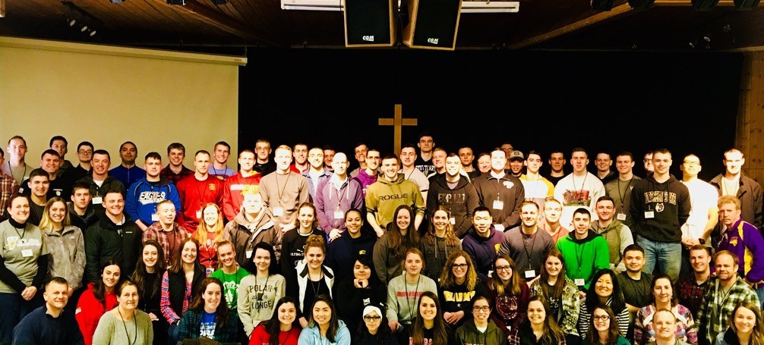
Where do we tell “Our Story?”
Notes:
SLIDE NOTES:
So we have talked about the power of telling our story and some key points to remember. So let’s now talk about WHERE we can tell our story?
ADMIN NOTES
This exercise should take just a few minutes. Just ask the group at large to answer aloud from their seats.
After soliciting response, then go to next slide where some of the major places are listed.
It is important because it shows that we already know many places to go, but there are also many we have not thought about yet.
This picture was taken in Iowa at a ROTC Cadet Christian Retreat! Cadet Command Chaplain attended, taught the lessons and was able to spend the whole weekend engaging with future Officers. Seeds were planted for the Chaplaincy.

Slide 12
Where do we tell our story?
Churches, Synagogues or Mosques, places of worship. Seminaries and other theological schools. Denominational conferences, councils, annual trainings.
Local hospitals with Clinical Pastoral Education programs.
Fellow Clergy from your denomination & outside your faith tradition.
Campus Ministry Pastors/Chaplains. Youth ministries. 56Ms who are involved with youth groups: tell your story about being a 56M!
ROTC programs at Universities: speak to classes, support FTXs, retreats, etc.
TDY trips: look for opportunities listed above when you travel.
Talk to your Endorser. Some of our Endorsers are our best recruiters.
Life cycle events like promotions, awards, retirements: conduct in conjunction with faith group gatherings and let it be a chance to promote Chaplaincy.
Scouting, Civil Air Patrol, JROTC
Notes:
SLIDE NOTES:
Obviously you can tell your story anywhere to anyone who will listen!
But here are some examples of the most common.
As you travel on TDY why not turn it into a potential recruiting trip as well? Look over this list and investigate to see what is available where you are going. You’d be surprised how with a little effort, you can fit into a TDY trip an excellent recruiting opportunity.
You’ll note the “life cycle event” idea. This came to us from a recently retiring CH(COL) who conducted his retirement ceremony, not on an Army post, but at a large gathering of missionaries and pastors within his faith tradition. His comment was, “I wish I had thought years ago of the idea to use life cycle events like promotions and award presentations as recruiting opportunities in alma matter and ecclesiastical type venues. I trust going forward that others can start acting on the idea sooner than I did.”
- Youth organizations like scouting, Civil Air Patrol and JROTC are also powerful places to plant seed for both 56A and 56M!
ADMIN NOTES:
You may have a story of not being overall concerned about recruiting while being a Chaplain but now you’ve changed and are more intentional in taking advantage of these normal, “every day” opportunities. Share that one purpose of ECAR is to help the Corps not wait until their retirement to see all the opportunities they had to tell their story along the way.

Slide 13
YES ROTC Cadets can branch into the Chaplain Corps!
So tell your story to them and/or visit an ROTC program!
Encourage Cadets to speak to their Cadre and a Chaplain Recruiter,
and to check out the CH Virtual Branch Orientation Page:
https://vbo.army.mil
Cadet Summer Training 2018: Six Cadets interested in the Chaplaincy with a CH Candidate who was
“their chaplain” that summer!
Notes:
SLIDE NOTES:
ROTC Cadets make an excellent pool of potential Chaplains, as their dedication to the Army, leadership development and physical fitness are already established. Many are not even aware that going straight from college to seminary/theological training is even possible.
This is why visiting ROTC programs can be so valuable. ROTC is focused on teaching leadership. So a suggested introduction would be expressing a desire to help educate their Cadets about the role and function of the Chaplains to help them to be better leaders. ICW talking about the call to serve as a Chaplain.
Sometimes the ROTC Cadre do not know how to help Cadets who are interested in the Chaplaincy so connecting the Cadets to the USACC Command Chaplain or a Chaplain recruiter is vital.
In the end, all Cadets wanting to go the route of the Chaplaincy will need an “ed-delay” from Cadet Command and then become part of the Chaplain Candidacy Program. Again more details on hidden slide.
For you, the key take away is YES it’s possible! Encourage Cadet to talk to their cadre, Cadet Command’s UMT, or a CH Recruiter to get the process started during their JR year.
ADMIN NOTES:
See hidden slide for details.

Slide 14
“How does diversity in our Corps helps ensure the right to the Free Exercise of Religion?”
Notes:
SLIDE NOTES:
Now let’s take some time to discuss the following question. What are your thoughts?
ADMIN NOTES:
This exercise should take 10 minutes. It is important because it shows that while its easier for us to recruit from within our own faith group, it’s important to have diversity in our corps to help take care of other Soldier’s religious needs as well. The key issue is to ensure the Constitutional right to the Free Exercise of Religion! Since a single Chaplain cannot provide for all religious needs, he/she needs a plurality of different chaplains to care for all of their Soldiers and Families in the most comprehensive way. Goal here is to see the benefits that come with “cooperating without compromise.”
Main point: while we are busy participating in ECAR “replacing ourselves” also look for good candidates from other backgrounds/faith groups who you think would be a team-player as a Chaplain, ultimately strengthening your ability to both perform and provide ministry to your Soldiers. As always we want the best applicants possible as we desire to see the Chaplaincy reflect the Soldiers it ministers to.
NOTE as well: no group, demographic or applicant has an unfair advantage or disadvantage. Yes we are looking more for certain demographics because we are short these. But everyone who meets the requirements goes before the board equally!

Slide 15
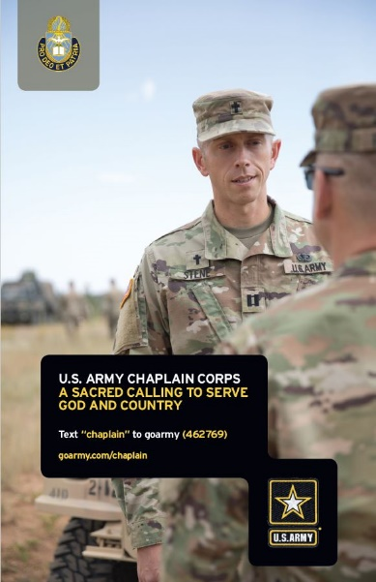
Leads: Where Do I Refer Them?
Easiest to remember: text “chaplain” to “goarmy”.
This connects them direct to a USAREC Recruiter for RA or USAR.
Send them a digital business card and/or the digital version of the brochure, “U.S. Army Chaplain Corps, a Sacred Calling to Serve God and Country.”
These and other handouts are available on our recruiting portal: https://usachcstraining.army.mil/ecar
ARNG: Connect them with a National Guard Recruiter:
1-800 GO-GUARD.
Refer them to their State Chaplain.
ng.ncr.ngb-arng.mbx.arng-hrr-specialty-branch-accessions@mail.mil
Notes:
SLIDE NOTES:
Texting the word “chaplain” to “goarmy” is a quick and easy to remember way to connect those interested in becoming an Army Chaplain. Process involves exchanging a few automated text messages, entering your email which then leads to you receiving an email with info taking you to the main goarmy/chaplain website.
Once there, you can fill out info to be contacted and within a day or so you should be called by a real person to start the processes. Contacts here are passed on either to the MRB for RA and USAR or the National Guard.
However, for those definitely interested in the National Guard, you are encouraged to connect them directly with a ARNG recruiter at 1-800-GO-GUARD. Or you can use the email which is the group
email box for the National Guard Bureau Specialty Branch Accessions to be able to put individuals in contact with the Chaplain Recruiter for their state. You can also refer to them their state chaplain. This info can be found by googling most states’ Chaplain page.
ADMIN NOTES:
- See ECAR Portal for slides with more information on COMPO 1 & 3 recruiting centers, as well as sites for the National Guard.

Slide 16
“U.S. Army Chaplain Careers” APP
Available in Any APP Store
Notes:
Last updated: 12/30/20
SLIDE NOTES:
For your situational awareness, this is what the current goarmy/chaplain web site looks like.
It is the link that is sent to anyone who texts “goarmy” to “chaplain.”
Some other sites are listed above as well.

Slide 17
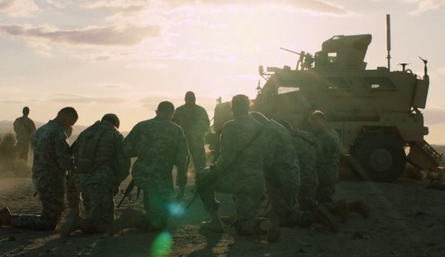
Army Chaplain Corps Social Media
Facebook: https://www.facebook.com/ArmyChaplainCorps - CH Corps https://www.facebook.com/USACHCSOfficial/ - USACHCS
YouTube: www.youtube.com/usarmychaplaincorps - CH Corps https://www.youtube.com/channel/UC-PfeUypTz0kP6Q1DxC_Wow - USACHCS Flickr: https://www.flickr.com/photos/armychaplaincorps/ - CH Corps https://www.flickr.com/photos/141293090@N06/ - USACHCS
Twitter: https://www.twitter.com/ArmyChaplains - CH Corps https://twitter.com/USACHCS1 - USACHCS
Instagram Send a photo showing your recruiting engagement to your followers linking @armychaplaincorps so it can be linked.
Notes:
SLIDE NOTES:
The Chaplaincy is well represented on Social Media now.
You can refer potential applicants here to see testimonials of those who are currently serving or in a current course at the schoolhouse. They can have a powerful effect in helping others see that they could do this too!
You can download these slides or take a picture of this to remember which sites you wish to access.
ADMIN NOTES:
All sites tested as of DEC 2020. If any links are not working, please let us know.

Slide 18
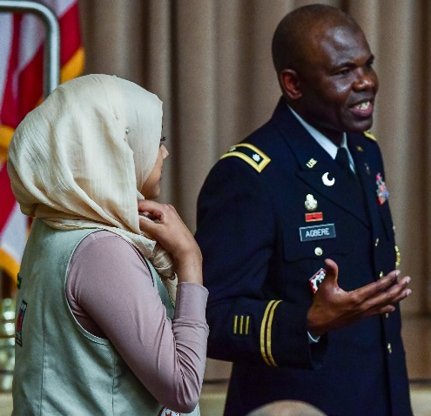
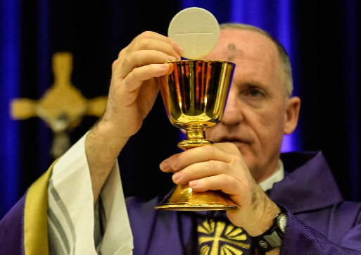
Key Army CH Corps Promotional Videos
On CH Corps YouTube Channel
Chaplain Testimonials from new CHBOLC graduates: Youtube Playlist
https://www.youtube.com/playlist?list=PLknkIwBOINAfBlOKhiIU3FV7tu_68bKDd
Professional Videos on the Chaplaincy: YouTube Playlist
https://www.youtube.com/playlist?list=PLknkIwBOINAcGj4gbP1Uun4fMWRYY6ey8
Watch all 4:
Story of the Four Chaplains – U.S. Dorchester – FEB 1943
History of the U.S. Army Chaplain Center and School
U.S. Army Chaplaincy – 56A
U.S. Army Religious Affairs Specialist – 56M
Notes:
SLIDE NOTES:
The Chaplaincy is well represented on Social Media now.
You can refer potential applicants here to see testimonials of those who are currently serving or in a current course at the schoolhouse. They can have a powerful effect in helping others see that they could do this too!
You can download these slides or take a picture of this to remember which sites you wish to access.
ADMIN NOTES:
All sites tested as of DEC 2020. If any links are not working, please let us know.

Slide 19
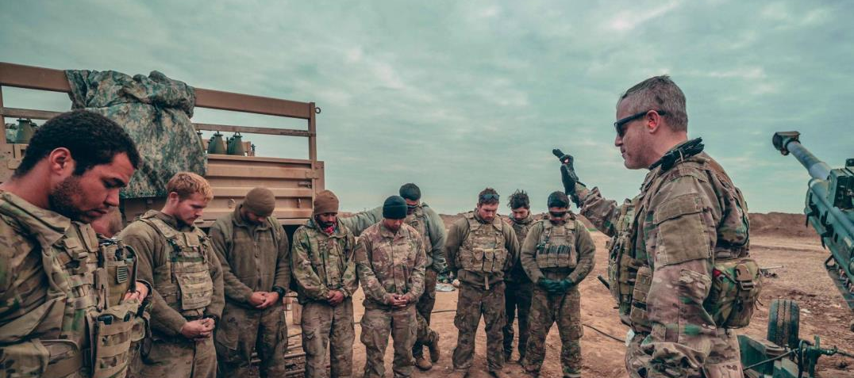
One final question:
“What do you see in this picture?
Notes:
SLIDE NOTES:
As we wrap up our training. What do you see on this slide?
Probe: get them to see the power of the ministry of the CH in this one photo, bringing God to Soldiers and Soldiers to God. This is what they get to do!
Now they get to invite others to come and join them!

Slide 20
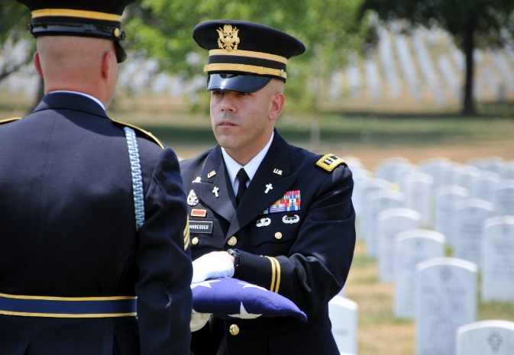
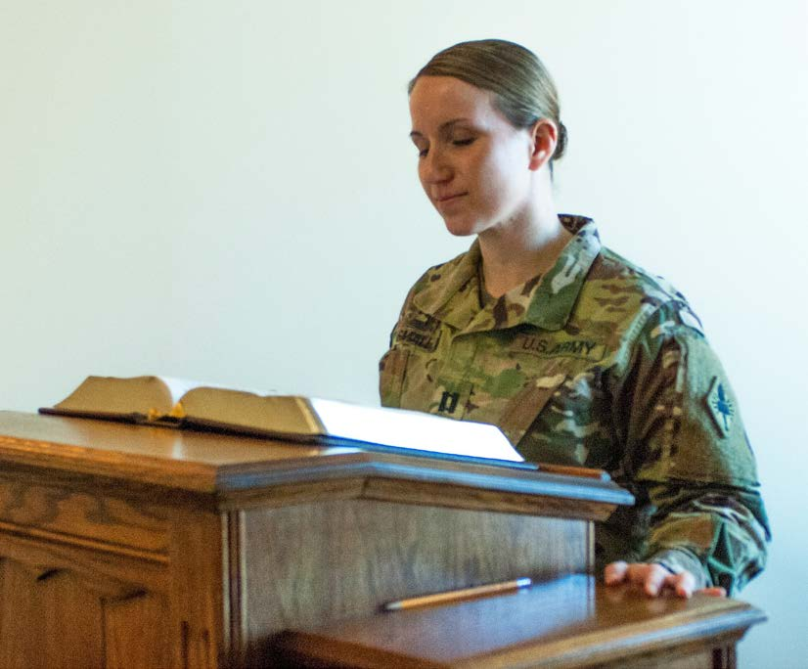
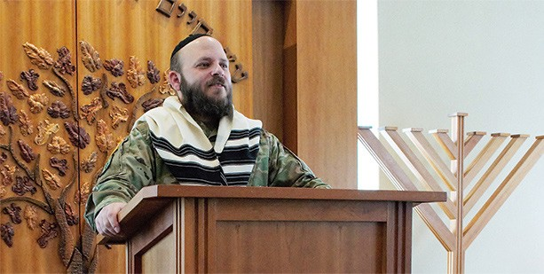
We Need a Chaplain Corps that Cares for the Souls of Soldiers & Families!
What are Your Questions?
U.S. ARMY CHAPLAIN CORPS
THREE COMPOS- ONE MISSION
Questions: occh-recruitingandaccessions@army.mil
Notes:
SLIDE NOTES:
Thank you for your attention and participation today.
Our hope is that today you’ve been motivated to participate in ECAR and that you see how you can play a pivotal role in filling our Chaplain Corps with men and women who are called of God and serious about the provision of the Free Exercise of Religion to our Army and their Families.
Again, any questions you have, please send an email to our “generic” email. Or you can email me directly. (Give out your info.)
Are there any final questions?
Close in prayer: prayer for our Chaplaincy, and for the Lord to raise up tomorrow’s Chaplains and Religious Affairs Specialists today and DREs!
ADMIN NOTES:
As you customize these notes, feel free to add in a slide with your personal contact info including email and phone.
You may, if you desire, go back and add in some phone numbers and emails for other contacts that had to be left out of this version that is hung on the portal.
Finally, as you present this training, please send constructive feedback to DACH-REC. Thank you.

