Slide 1

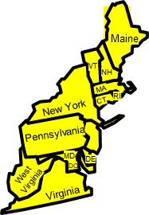


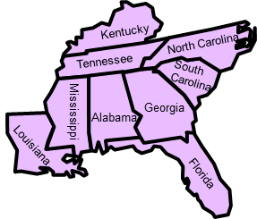


READINESS DIVISIONS and
CHAPLAIN PERSONNEL MANAGERS
RD chaplains have a list of all units with vacant chaplain positions
-Please contact the chaplain personnel manager for the state you are located in or going to locate in for support
88th Readiness Division, Fort McCoy, WI
Chaplain (LTC) Vicente Cepeda
vicente.v.cepeda.mil@mail.mil
608-388-0341
7th CSC Kaiserslautern GE
Chaplain (LTC) Ray Ayers
raymond.l.ayers2.mil@mail.mil
DSN 314-528-0249
Europe
Washington
Montana
North Dakota
Minnesota
Oregon
Idaho
South Dakota
Wisconsin
Michigan
99th Readiness Division, ASA Dix
Chaplain (LTC) Steve Blackwell
(after 06 JAN 20)
609-562-7448
Wyoming
Nebraska
Iowa
Ohio
63rd Readiness Division, Moffett Field
Chaplain (LTC) Sung Kim
650-526-9214
Sung.n.kim.mil@mail.mil
Kansas
Illinois
Indiana
Nevada
Utah
Colorado
Missouri
California
81St Readiness Division, Fort Jackson
Chaplain (LTC) Robert Farmer
803-751-9634
robert.m.farmer.mil@mail.ml
Arizona
New Mexico
Oklahoma
Arkansas
Texas
9th MSC, Fort Shafter
Chaplain (COL) Charles Causey
808-438-1600 x3507
charles.m.causey.mil@mail.mil
AK,HI, US Territories, Asia
1st MSC, Fort Buchanan
CH (MAJ) Wanda I. Acevedo
1st Mission Support Command
Ft. Buchanan, PR 00934-4608
Office: 787-707-4956
Mobile: 939-227-6769

