Slide 1
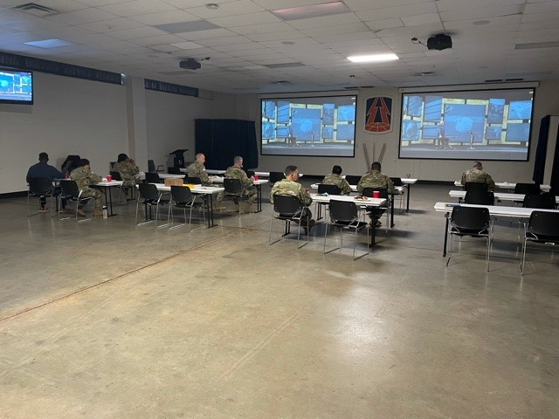
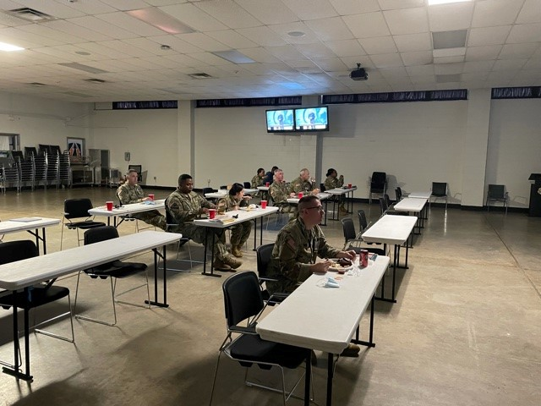
335th Signal Command (Theater)
Event: Strong Bonds Alpha Event – 335th Signal Command (Theater) HHC
Date: Thursday, 4 November 2021
Activities: Financial Wellness TNG using Dave Ramsey’s Financial Peace University Videos. Participants
enjoyed a delicious catered BBQ meal during the training sessions.
Objective: Increase individual Soldier readiness; provide TNG to equip Soldiers with personal finance
management principles.
Results: 14 Soldiers trained.

