Slide 1
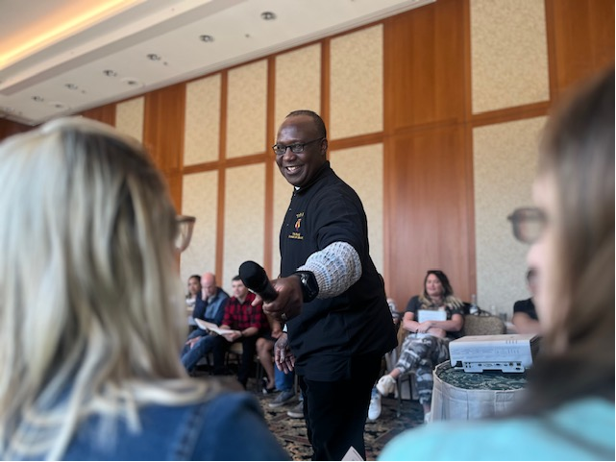
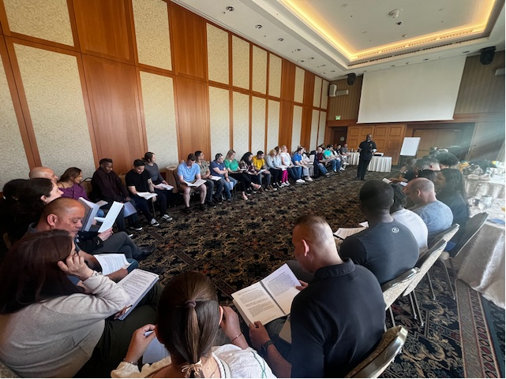
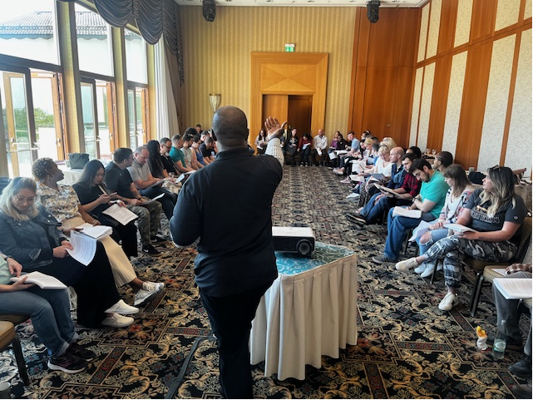
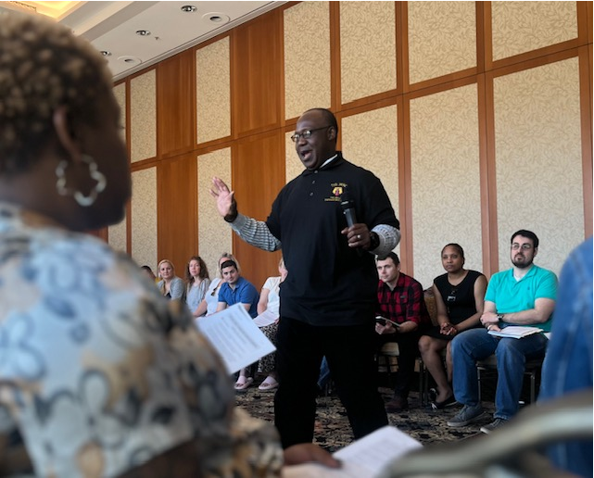
7th Mission Support Command
WHO: 7th Mission Support Command
WHAT: Building Strong and Ready Teams (BSRT) Couples/Family Event
WHEN/WHERE: 05-07 APR 2024, Garmisch-Partenkirchen, Germany
SUMMARY: During the weekend of 05-07 APR 2024, CH (MAJ) Christopher Obilam, the Brigade Chaplain for the 510th RSG, served as the lead instructor of a BSRT Couples/Family Event at Edelweiss Lodge and Resort in Garmisch-Partenkirchen, Germany. CH Obilam taught the curriculum “Active Military Life and Resiliency Skills”. Within this curriculum there were blocks of instruction on Communication Styles in Military Communities, Getting Rid of Destructive Behaviors, and Compassion & Forgiveness.
The participants were from the 7th HQ, 510th, 83rd, 446th, 773rd, MSU, 2500th, 7th ILE, 729th, and 163rd (26 Couples). Childcare was also provided for the 35 children, ages 0-12 years old.
PURPOSE: The 7th MSC Religious Support Team will plan and execute a BSRT Charlie Event for it’s HHC and DRU’s. A Couples Event was selected to address the increase in counseling trends related to the category of “Marital, Relationship, Family”.
USAREUR LOE’S
Set the Theater
Present Combat Credible Forces
Mission Command JFLCC OPS
Enhance Relationships and Interoperability
OCHAP RS Priority Efforts
Soldier and Family Care Through Religious Support
Moral and Ethical Leadership and Unit Morale
UMT Training and Operational Readiness
ASCC/JFLCC Theater Supervision of RS
Interoperability and Partner Coordination
Set the Theater
The Religious Support Teams within the 7th Mission Support Command identify issues within the formation via confidential counseling. Trending upward, are issues related to marriage, relationships, and family. To address this trend, an overnight Couples relationship training event was planned/executed.
Soldier & Family Care
Providing Religious Support through relationship training increases the resiliency of the couple and family, resulting in the strengthening of the overall readiness of the Soldier.
SFC Turner, 7th MSC
Senior Religious Affairs Specialist, DSN 528-0252
Notes:
Do not adjust the size of the photo boxes. Crop photos to fit in the boxes.
Arial font only
You may adjust the font size (up or down) of the 5Ws, Summary, and Purpose slides to make sure the content fits.
You may adjust the height of the 5Ws, Summary, and Purpose slides to make them evenly contain the text if you need to, but do not adjust the width.
Make sure the LOEs and POEs are explained in the three adjacent boxes.
Clearly indicate how the event supported the LOE & POE in one or two sentences.
You may adjust the size of the font in the Three Focus Areas boxes to make the text fit, but make sure that the fonts in all three boxes are the same.
You may adjust the width of the Focus Area Boxes slightly to make the text fit, but do not adjust the height, and do not move the boxes any further left than they already are.
Make sure you highlight the LOEs & POEs by making them bold, italicized, and green.

