Slide 1
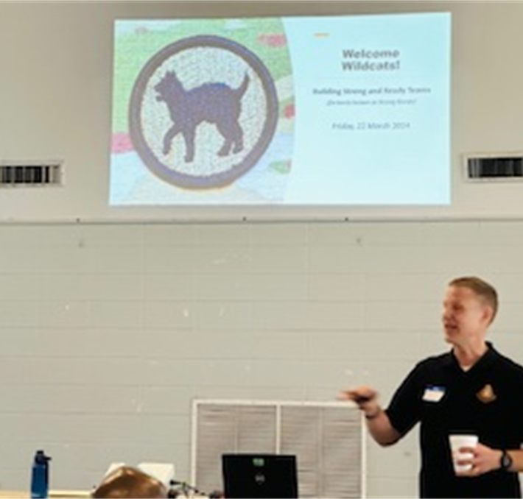
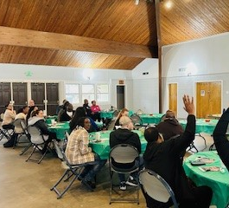
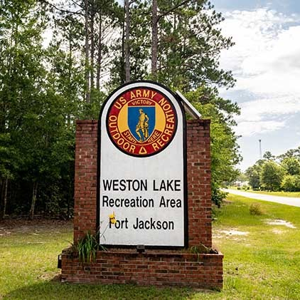
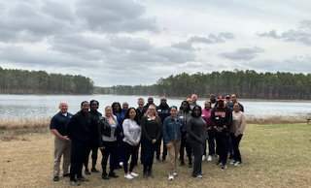
Wildcats Never Quit!
On March 22, 2024, the 81st Readiness Division Chaplain Section hosted a Building Strong and Ready Teams event for the full-time 81st Soldiers at the beautiful Weston Lake MWR in South Carolina.
The curriculum for this event included the OXYGEN modules “Leading From Your Strengths” and “Appreciation Styles.” The three-hour block of training began with CH(MAJ) Bartholomew Martin focusing on the OXYGEN personality assessment taken by each Soldier. Participants were challenged to understand their own personality strengths and how they can use those strengths to form stronger families and more effective teams in the workplace.
The 81st Chaplain Section provided coffee and snacks from Chick-Fil-A in the morning and after the event provided lunch catered by Moe’s Southwest Grill.

