Slide 1
Strategic ethics for the supervisory Chaplain
805D-56A7-ETH
Prepared by CH (MAJ) Dan Kersey
US Army Chaplain Center & School
For BDE Functional Course
JUN 2019
“The views, opinions and findings contained in this report are those of the authors(s) and should not be construed as an official Department of the Army position, policy or decision, unless so designated by other official documentation.”
Notes:
Task Taught:
Task Supported: 805D-210-8000, 805D-211-8117
Task Reinforced:
Outcomes: 1, 2, 3, 6, 7, 8, 9
Knowledge Taught: K25071, K25072, K25073, K25076, K25078, K25079
Skill Taught: S3869, S3872, S3873, S3874, S3878, S3879, S3890, S3891
The length of instruction is: 3 hours / min
Special instructions to the instructor: Print handouts prior to class, ensure students receive read ahead materials prior to classroom instruction
Reference Materials:
AR 165-1
FM 1-05
ATP 1-05.04(Draft)
ADRP 6-22
DA PAM 165-16(Draft)
ADRP-1

Slide 2
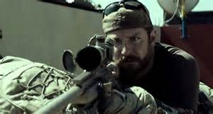

Slide 3
Terminal learning objective
Action: Understand critical role of chaplain as an ethical moral advisor, moral developer, and Supervisor at the Strategic level.
Conditions: Given classroom instruction, classroom discussion, handouts, case studies, and practical exercises.
Standard: Students will develop an understanding of Supervisory Chaplain’s role in the area of ethics and morals. Students will also develop plan to strategically execute moral leadership training.

Slide 4
Learning steps and activities
Analyze strategic elements of the Army Profession and the Army Ethic
Evaluate role of chaplain as the ethical moral advisor to Command
Plan strategically to execute Moral Leadership Training for Division and higher
Notes:
The learning steps and activities for this class are:
Analyze strategic elements of the Army Profession and the Army Ethic
Evaluate role of chaplain as the ethical moral advisor to Command
Plan strategically to execute Moral Leadership Training for Division and higher

Slide 6
“Chaplain sections and UMTs are organized to respond to the religious and moral needs of Soldiers, their Families, and other authorized personnel.”
“All chaplains and religious affairs specialists will remember that they represent their nation, the Army and the Chaplain Corps. They are therefore charged to uphold the highest professional, moral, and ethical standards at all times as they model the Army Profession and Ethic.”
“As the professional military religious staff advisor, the chaplain advises the commander and staff on morals, morale, ethical issues, and the impact of religion on all aspects of military operations.”
from AR 165-1 2-2 c, f; 2-3 2

Slide 7
do
know
BE
Notes:
.

Slide 8
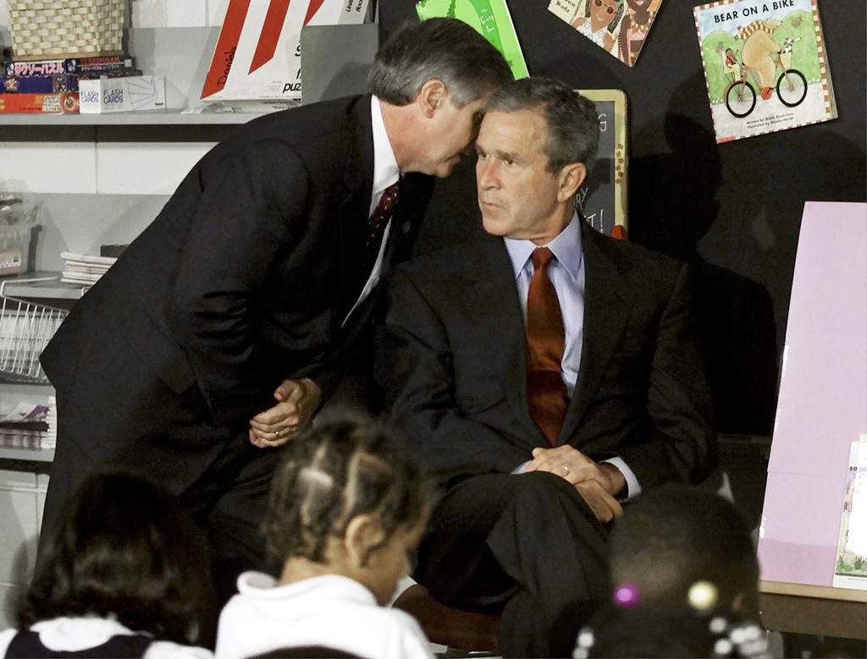

Slide 9
Professional Character Development
JUST WAR PRINCIPLES
OPERATIONAL ENVIRONMENT
REGULATIONS
ARMY NORMS
Reflection
Professional Character
Maturity
Identity
Judgment
Self-Awareness
Ownership
Strength
Courage
Confidence
Self Discipline
Resilience
UNIT CULTURE
Feedback
Ethical Processing
ROE
SOPs
Recognize the Conflict
Evaluate the Options
Commit to a Decision
ACT
Thinking
VIRTUE
RULES
OUT
COMES
Motivation
ORDERS
WARRIOR ETHOS
ARMY VALUES
The Professional’s Battlespace

Slide 10
Evaluate the Options | Virtues/Values | Outcomes | Rules
COA 1
COA 2
COA 3
COA x

Slide 11
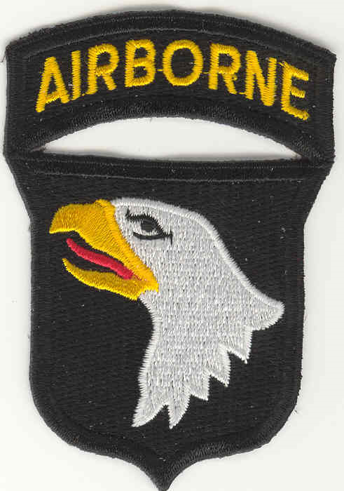

Slide 12
you da boss, now what you gonna do???

Slide 13
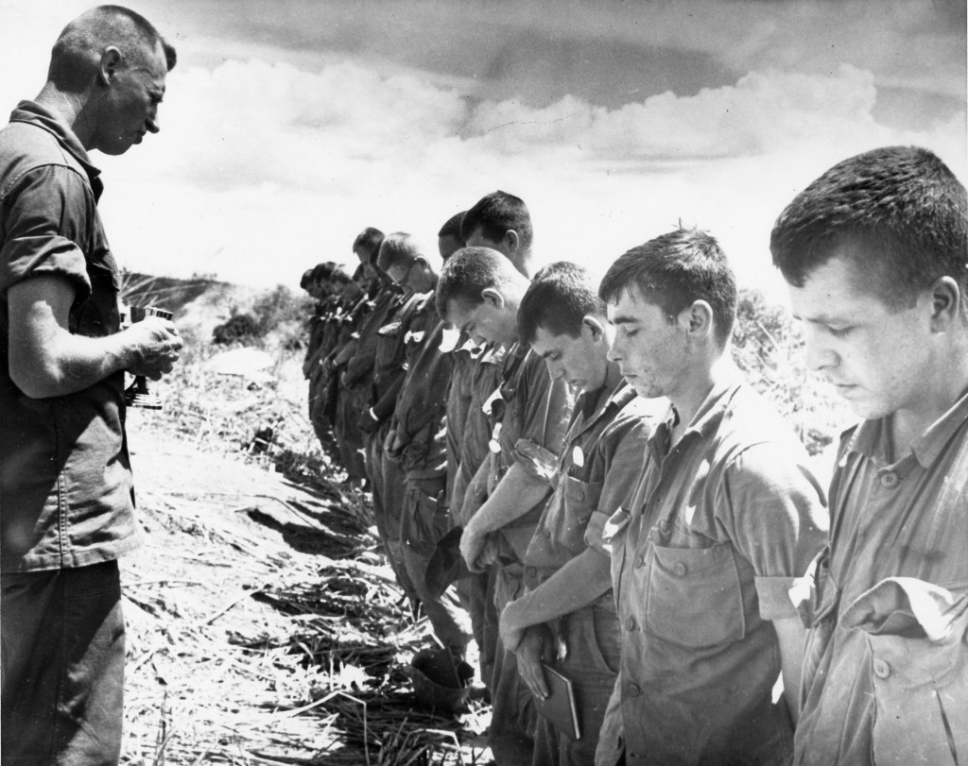

Slide 14
questions
Notes:
TIME FOR YOUR SUMMARY / CONCLUSION SLIDES:
What are your questions regarding the Strategic Ethics for the Supervisory Chaplain?

Slide 15
Check on Learning
What document defines the Army Ethic?
Name one lens for evaluating possible ethical/moral COAs.
What document identifies chaplains as internal advisors?
Who is responsible for ethical and moral development of Soldiers and Leaders?

Slide 16
Terminal learning objective
Action: Understand critical role of chaplain as an ethical moral advisor, moral developer, and Supervisor at the Strategic level.
Conditions: Given classroom instruction, classroom discussion, handouts, case studies, and practical exercises.
Standard: Students will develop an understanding of Supervisory Chaplain’s role in the area of ethics and morals. Students will also develop plan to strategically execute moral leadership training.
Notes:
The terminal learning objective for this period of instruction was:
Action: Understand critical role of chaplain as an ethical moral advisor, moral developer, and Supervisor at the Strategic level.
Conditions: Given classroom instruction, classroom discussion, handouts, case studies, and practical exercises.
Standard: Students will develop an understanding of Supervisory Chaplain’s role in the area of ethics and morals. Students will also develop plan to strategically execute moral leadership training.

Slide 17
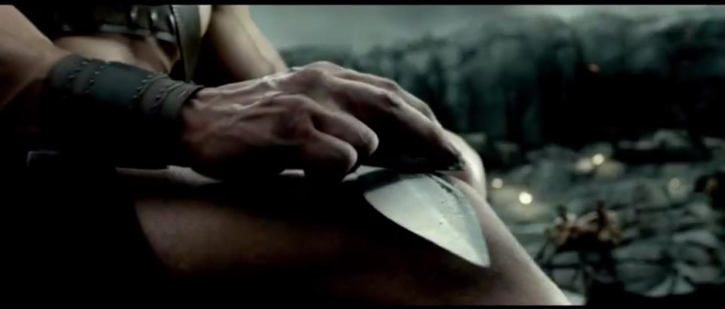
Notes:
Review/Summarize Lesson:
In this lesson we learned:
Analyze strategic elements of the Army Profession and the Army Ethic
Evaluate role of chaplain as the ethical moral advisor to Command
Plan strategically to execute Moral Leadership Training for Division and higher

