Slide 1
Introduction Chaplain Corps UMT Training Active Threat in Garrison Chapels
IMCOM-Europe
USAG Stuttgart
Religious Support Office
Dr. Becky Powell, Rebecca.a.powell16.civ@mail.mil
17 October 2019
Notes:
Instructional Lead In: Give your name and your background that supports and lends credibility to being the one teaching the class.
Handouts:
Stuttgart Chapels – Catholic – Usher Greeter Offering (Non-Specified)
Be Sure To… Slide 4 with Maps
Shooter and Bomb Real USAG Stuttgart RSEPP Annex L
Chapel Child Protection Brochure Stuttgart 2019
Sample Rules and Consequences
Program Check In and Out
2019-2020 Calendar Jewish
2019-2020 Calendar Protestant
2019-2020 Calendar Catholic
Responding to an Active Shooter Crisis Situation – FBI
Resources to Protect Your House of Worship – FEMA
Certificate of Completion
CY 19 Volunteer Academy Brochure
VBS 2012 Emergency Plan Landstuhl
Special Needs and All Needs – Audit of Barriers
Fort Leonard Wood Scenario
Fort Leonard Wood Scenario map
Intruder Scenario Sand Table Worksheet

Slide 2
Terminal Learning Objective
ACTION: Apply the Active Shooter requirements and resources to local garrison chapel situations and locations.
CONDITIONS: In a classroom environment, given access USACHCS Training Portal and sample standard operating procedures.
STANDARD: Applying includes:
Identifying the elements of an Active Threat scenario.
Selecting Courses of Action in response to a scenario.
Organizing response based on program characteristics and personnel available
Notes:
Instructor Note: Have students silently read the TLO.

Slide 3
Administrative Information
SAFETY REQUIREMENTS: Use care and caution when moving around the classroom. Identify and know the nearest exit.
RISK ASSESSMENT LEVEL: LOW
ENVIRONMENTAL CONSIDERATIONS: Clean up after yourself and recycle when possible (plastic bottles and paper).
EVALUATION: The student is required to fully engage in lesson by applying critical and creative thinking throughout the lesson as well as complete all assignments.
Notes:
Instructor Note: Review safety requirements, risk assessment, environmental considerations and expected outcome and evaluation.

Slide 4
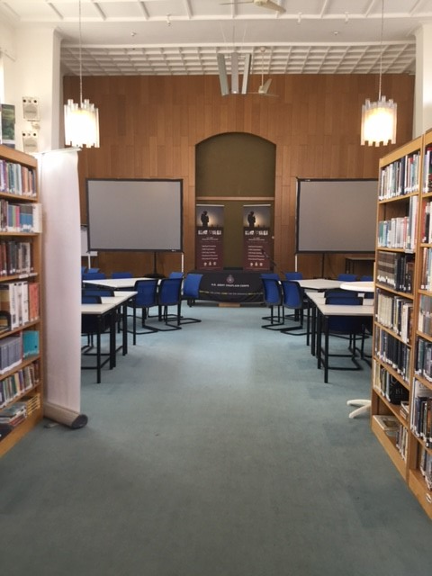
Introduction
Active Threat
Notes:
Welcome to Active Threat Training for UMTs.
We are using the active shooter training published by the US Army Chaplain Center and School at https://usachcstraining.army.mil/religious-education.
I am using the language of Active Threat rather than Active Shooter because an attacker in a chapel setting might come with some weapon other than a gun.
We will spend the next few minutes going through the Active Shooter online training today. As we go through this together, we will engage in some activities and review regulations and resources. The goal is to get us started in readiness for threats to chapel safety.

Slide 5
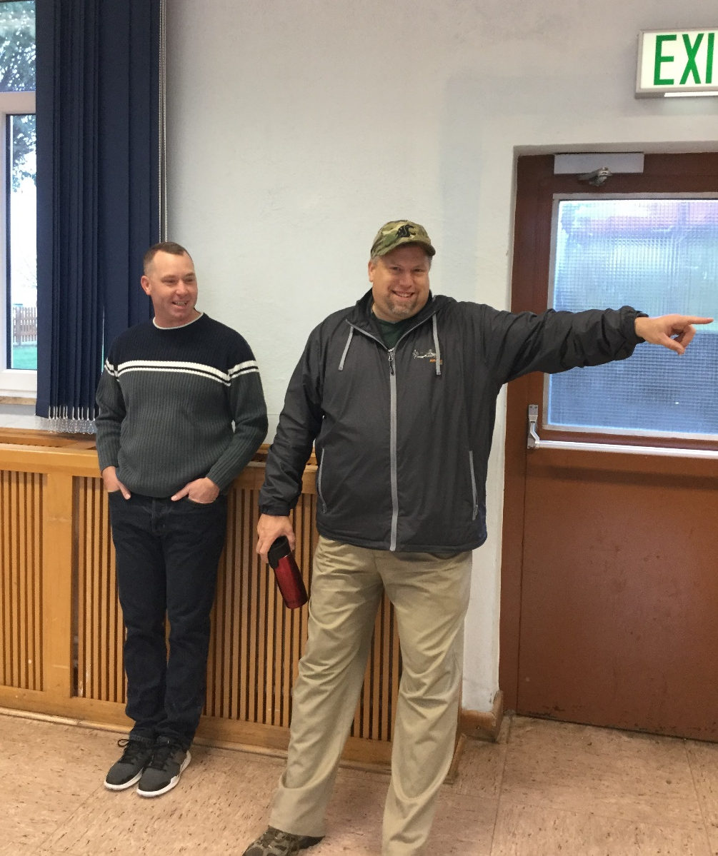
Chapel Roles
Active Threat
Notes:
Before we begin our training video, we want to keep in mind that each person in the chapel is present with a particular role.
The only personnel who are combatants are Religious Affairs Specialists.
Chaplains are non-combatants, but they have a formal role in the leadership of all programs.
Civilian employees (Religious Educators and administrators) have a formal role which is defined by position description but may have other duties as assigned.
Contractors are bound by the parameters of their contract.
Chapel Volunteers are those who have been recruited and agreed to serve in a specific role. I have provided you a position description for Ushers. These volunteers will be the most visibly present in an Active Threat situation.
All other personnel are chapel attendees and are part of our vulnerable population.
I propose that a result of today’s training we develop a training specifically for the various needs our Volunteer Ushers meet.

Slide 6
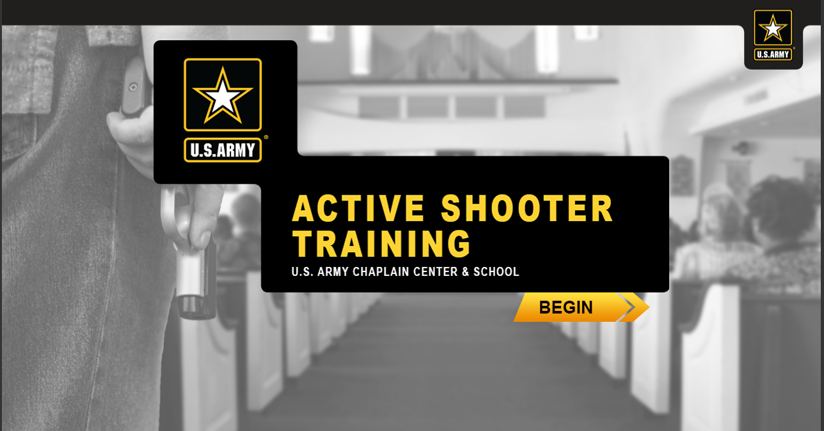
Training Video
Active Threat
Notes:
Play the training video. If you are able to use the online training, then stop at each activity and conduct the activity together. To do the online training, use either Firefox or Google Chrome.
https://usachcstraining.army.mil/religious-education
https://train.gordon.army.mil/chaplain/ActiveShooter/index.html
If you cannot access the online video, then use the demo video saved to disc.
As you go through the activities, use the provided handouts at the below listed points.
Slide 4 (Demo video Minute 1:29) – Handout - ”Be Sure To slide,” “emergency maps”, and “Religious Support Emergency Preparedness Plan (RSEPP).”
Say – these resources will help up us in a closing activity and to think about our actual locations as we go through this training.
Slide 5 (Demo video Minute 2:04) – Pause on the slide with children – Handout “Child Protection Brochure” and “Sample Rules.”
Say Child Protection and rules in classrooms are more than just for the implementation of lessons. They also have our program participants ready to react/respond to an emergency.
Slide 5 (Demo video Minute 2:23) – Pause on a slide that says “Take accountability of your assigned attendees.”
Handout “Program Check in and Out”, “Calendars.”
Say – “Taking accountability is difficult. HQ IMCOM requires that we keep the NUMBERS of worship attendees and the rosters of Religious Education (child, youth, adult) attendees. As you prepare for the possibility of emergencies, this is a good time to improve how you implement programs. The IMCOM Europe Chaplaincy Academy for Religious Education has a class available for program planning which helps with these ideas. You will use these calendars and check in forms in the activity at the end of today’s session. Based on your chapel ROLE, build a list of how you can be aware of the attendance numbers, rosters, and calendars for YOUR chapel?”
Pause to get answers.
Slide “Your Options During an Active Shooter Event” – If you are using the online interactive training, then you will be able to pause and do the following conversation points within each “Option” button.
If you are doing the Demo Video, you will need to pause the video at the given times to do the following conversation points
EVACUATE – pause at Demo Video 3:38 – Ask “Identify the most likely form of threat at each of your buildings.” List each particular chapel building and give the class time to answer for each. (examples – at Patch Chapel, the attack might be nearby at EUCOM; at Panzer the chapel there are many points of entry; at Robinson the threat might be from surrounding buildings; at Kelley the threat might be nearby to AFRICOM.)
LOCKDOWN – pause at Demo Video 4:46 – Ask “Plan how you would have people lockdown when the sanctuary is full.”
HIDE – pause at Demo Video 5:05 – “How would you solve the issue of barricade for a sanctuary? What other rooms are difficult to barricade?”
TAKE ACTION – pause Demo Video 6:28 – “What further solutions do you have for a complex day at the chapel?””
CHECK ON LEARNING – pause Demo Video at 6:40 – Have the group decide the matching answers together. You will see the correct answers when the video restarts.
Slide Question “responsibility of the chaplain”
Pause the Demo Video at 8:02 – have the group answer the question. You will see the correct answer when the video restarts.
Slide Question “Private Owned Weapon”
Pause the Demo Video at 8:05 – have the group answer the question. You will see the correct answer when the video restarts.
Slide Question “action MUST personnel take”
Pause the Demo Video at 8:09 – have the group answer the question. You will see the correct answer when the video restarts.
When the video ends, turn off the video and go back to the slides.

Slide 7
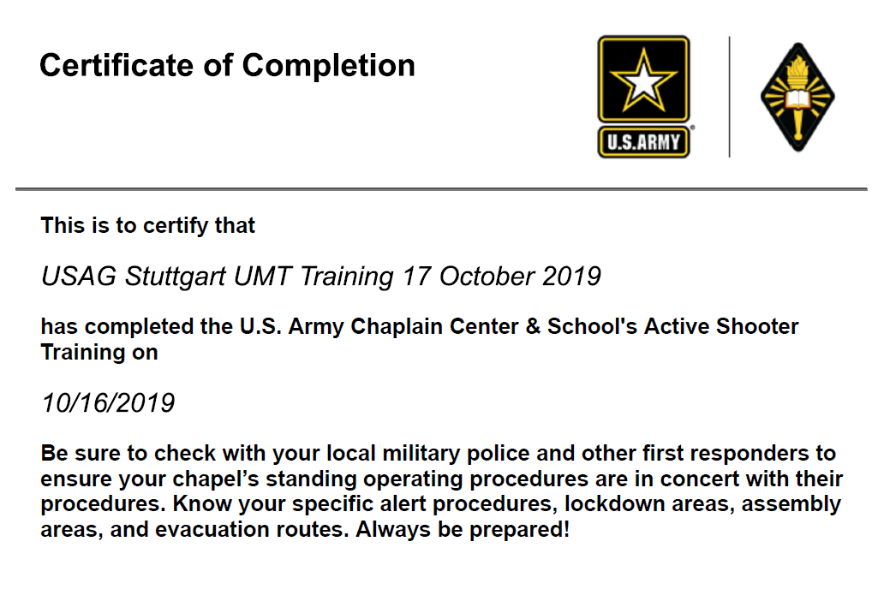
Links and Resources
Active Threat
Notes:
In your handouts, you have a certificate of completion for today’s course.
There are additional resources and links provided in the online training. I have printed and provided you with information from the FBI and from FEMA. There are additional trainings and certifications that these organizations provide. You can also get training in the Army Emergency Management Exercise Evaluation Course (information from the Garrison Chaplain or HQ IMCOM).
These resources are helpful for you as you plan within our religious locations.
Note that religious locations are often a target of active threats, shooters and otherwise.
Vigilance allows us to have secure buildings and successful programs.
The Religious Affairs Specialists and Military Police are the experts on our security. Today’s training and the online course were written with guidance and instruction from these leaders from USAG Ansbach.

Slide 8
Volunteer Academy
Active Threat
Notes:
This training is one of many trainings written and provided by Dr Grace Yeuell and Dr Becky Powell since the founding of the CARE Center and Volunteer Academy.
You have been provided with a brochure of other courses for this year.
If you would like a course to be taught for your congregation or group, you may contact them or see the published lesson plans on the USACHCHS Training Portal.

Slide 9
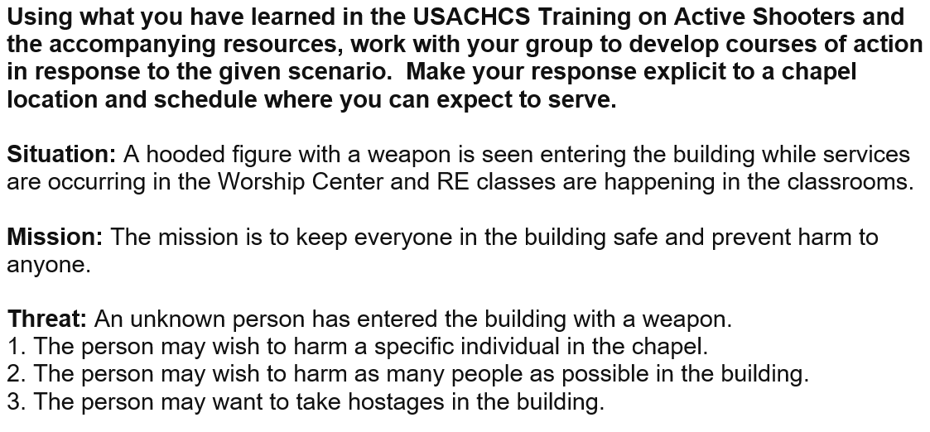
Intruder Scenario
Active Threat
Notes:
This is the last portion of our training and is an activity which will likely continue for days and weeks.
Your last handouts today are:
Sample Emergency Plan from Landstuhl Chapel. This goes along with the RSEPP given out earlier in our class. These are samples that you can use to build the Emergency plan for your chapel.
Audit of Barriers from the Volunteer Academy training on Special Needs. As you plan for emergencies, remember that there are people who have needs to be considered – mobility, vision, hearing, emotional. Prepare to assist these individuals and keep them in mind as you respond in any way.
Fort Leonard Wood Intruder Scenario document and map. This was used by their Director of Religious Education (Martha Strong) and NCOIC to plan for Active Threat intruders in their chapels. Use this as a model for your activity.
The last handout is your worksheet. Use the information you have seen/heard along with the resources which you have been given.
Your task is to plan 3 courses of action (COAs) for responding to an Active Threat in the chapel where you serve.
Work in a team with others for your selected location. Keep in mind the schedule and needs of the personnel present during your scenario.
When you are complete, hand a copy of your worksheet to the instructor for review and for sharing with the Senior Chaplain of your installation.

Slide 10
Terminal Learning Objective
ACTION: Apply the Active Shooter requirements and resources to local garrison chapel situations and locations.
CONDITIONS: In a classroom environment, given access USACHCS Training Portal and sample standard operating procedures.
STANDARD: Applying includes:
Identifying the elements of an Active Threat scenario.
Selecting Courses of Action in response to a scenario.
Organizing response based on program characteristics and personnel available
Notes:
Instructor Note: Have students silently read the TLO.
Say:
Thank you for your support and best wishes on your career in service to God and Country.

