Slide 1
Chaplain Identity & pastoral care
Prepared by CH (MAJ) Wallace Waldrop and CH (MAJ) Mike DeRienzo
For the Operational Religious Support Leaders Course
United States Army Chaplain Center & School
16 January 2020
“The views, opinions and findings contained in this report are those of the authors(s) and should not be construed as an official Department of the Army position, policy or decision, unless so designated by other official documentation.”

Slide 2
What’s my name? - move around the room asking different people One yes or no question - SIT DOWN WHEN YOU guess correctly
Notes:
"What is my name?" Game (Motivator)
Instructor Note: Each student is given a prefabricated 3 x 5 card with the name of a famous
person/celebrity and a cover sheet. The student places the card on their forehead and
then removes the cover. Students ask other people ‘yes or no’ questions to figure out who they
are. Each student may only ask each individual 1 question. Allow 5 minutes of questioning.
Instructor Note: The purpose of this activity is to define three key terms we will use today.
(Display slide 3)

Slide 3
Terminal Learning objective
ACTION: Determine how developing chaplain identity informs pastoral care and supervision.
CONDITIONS: In a classroom, given access to regulations AR 165-1 and FM 1-05
STANDARD: Determine how developing chaplain identity informs pastoral care and supervision by: 1. Determining the correlation between chaplain identity and pastoral care 2. Comparing differences between company and field grade identity 3. Validating understanding of chaplain identity, pastoral care and supervision
Notes:
STATE: Here is the terminal learning objective.
Instructor Note: Refer to lesson plan notes before advancing to next slide.

Slide 4
Self
Soul
Spirit
Notes:
LSA 1: [45 minutes] Determine the correlation between chaplain identity and pastoral care.
STATE: The purpose of our previous activity was to establish three key terms we will use today. We will start with the term “Identity”
Instructor Note: For this slide, encourage students to use a dictionary and look up “Identity,” “ Self,” “Soul,” and “spirit”. See if a good working definition of identity can come from studying these words.
*Have a recorder put the ideas on white board to facilitate a working definition of ‘identity.’
(Display Slide 5)

Slide 5
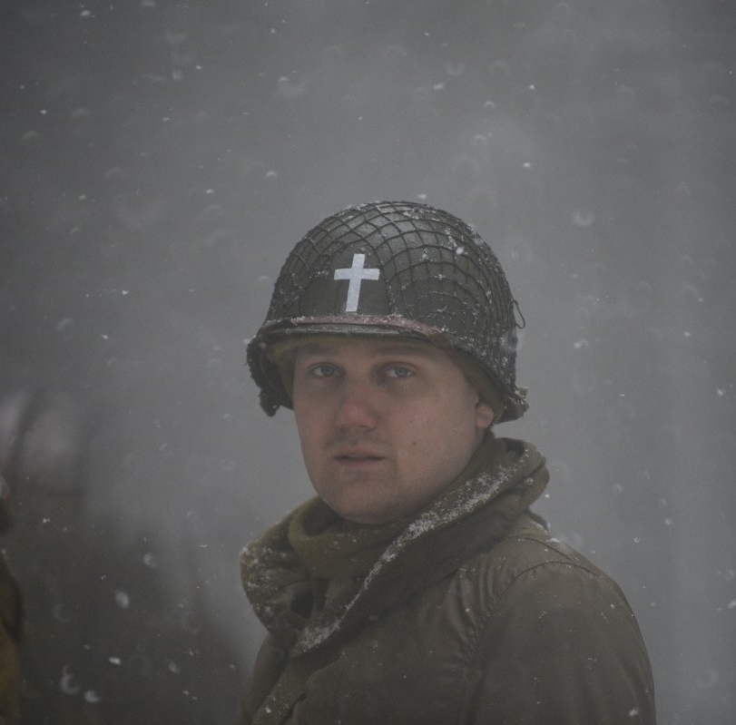
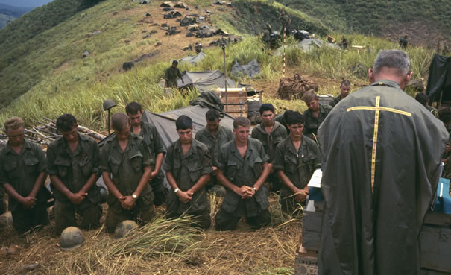
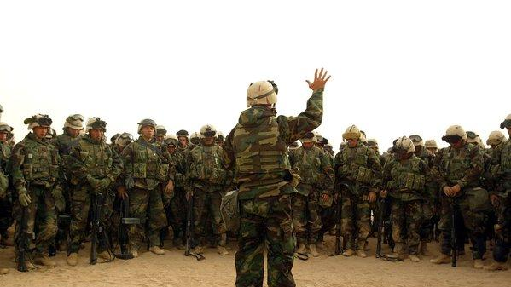
Advisor
Advisor
Prophet
Prophet
Religious Leader
Religious Leader
Military Leader
Military Leader
Servant
Servant
Chaplain Identity
Notes:
STATE: The Chief of Chaplains has highlighted the importance of chaplains work being found in a healthy identity.
A recent study performed by a working group appointed by CH Hurley identified 5 elements of chaplain identity: Advisor, Prophet, Religious Leader, Military Leader, and Servant.
ASK: What is your reaction to these 5 elements?
Instructor Note: Discuss at tables to gather ideas and report back to whole group after 4-5 minutes.
ASK: How does the phrase “Chaplain Identity” or “ecclesiastical identity” make sense to you?
How would you define “Chaplain Identity”?
Instructor Note: *Each person writes their own definition on notecard, then each group discusses to come up with one definition.
(Display Slide 6)

Slide 6
Chaplain Identity
Officer
Minister
Chaplain Identity
Service to God
Called / Set Apart
Sacred
Religious Values
Sacred Texts / Oral
Traditions
Obedience / Love
Service to Country
Commissioned
Secular
Army Values
US Constitution,
Law, Regulation
Patriotism
It is a unique, divine calling and state of being for the special ministry of the US Army Chaplaincy demanding the blending of clerical and Army officer identity to create a new, distinct identity that is more than the sum of its parts.
Advisor
Prophet
Servant
Army Officer Identity
Civilian Religious Identity
Notes:
Instructor Note: Discuss each section as a class as it populates, and ask each group to consider their definition compared to the one above. *Allow 2-3 minutes table discussion time.
(Display slide 7)

Slide 7
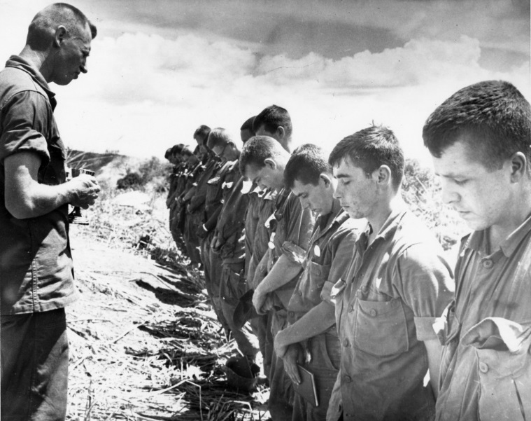
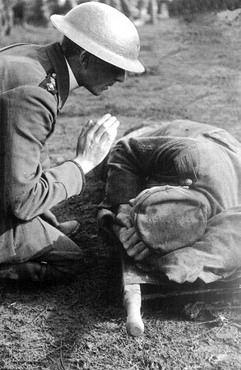
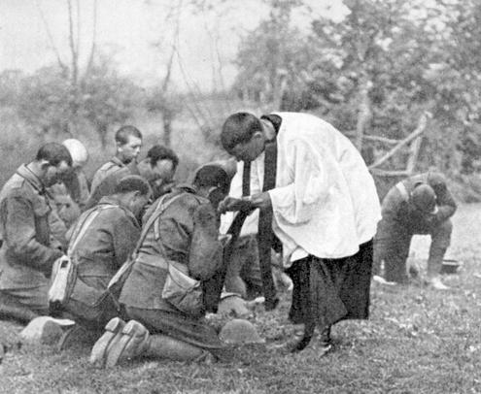
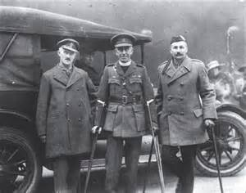
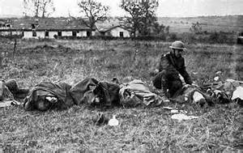
Pastoral Care
Notes:
ASK: What exactly is pastoral care?
STATE: There is one sheet per table and I would like each person to take a turn to write their thoughts on that paper.
After everyone has a chance to write, review as a group. Is there anything else that may need to be added?
Instructor note: Allow 7-8 minutes
ASK: How is pastoral care connected to the concept of identity?
How does the definition of identity your group came up with, connect to what you all wrote on the pastoral care sheet? (Discussion in groups)

Slide 8
“The False Self is the person we wish to present to the world, the person we want the world to revolve around.”
-James Martin
Notes:
LSA 2: [50 minutes] Compare differences between company and field grade identity.
Instructor note: Allow students to read quote.
STATE: If we are not intentionally developing or maturing in our identity, we run the risk of (at best) operating from an immature identity or (at worst) operating from a false self.
Field grade leadership demands a field grade identity. Field grade chaplains must embrace and develop a field grade chaplain identity.
(Display Slide 9)

Slide 9
“The problem of sanctity and salvation is in fact the problem of finding out who I am and discovering my true self.”
-Thomas Merton
Notes:
Instructor Note: Allow students to read the quote.
STATE: Identity and pastoral care are closely connected. In the old leadership construct of BE-KNOW-DO, identity is the "BE" and the pastoral care is the "DO". Focusing on and developing a healthy identity allows for excellence and consistency in the delivery of pastoral care that is useful and good.
Consider thinking about the connection between identity and pastoral care in the old leadership construct of BE-KNOW-DO. The BE is identity, who we are and our maturity, the KNOW is knowledge and skills needed to do a job, and the DO is performing chaplaincy tasks and the ministry of religious support in the Army.
(Display Slide 10)

Slide 10
W O was
?
Battalion Chaplain Identity
Notes:
ASK: How would you define company grade chaplain identity? It may be helpful to think in terms of what do 1LT/CPT chaplains need to be-know-do.
What do you think about the chief’s study group construct (Prophet, religious leader, military Leader, Advisor, Servant…) as it relates to what a Company Grade Chaplain ultimately does?
Answer: Company Grade chaplain identity enables them to be the primary Doers of direct religious support.
(Review) ASK: What are the elements of BN Chaplain Identity?
Answer: Prophet, Religious Leader, Military Leader, Advisor, Servant…
STATE: A BN / company grade chaplain is a “doer” of religious support with a focus on Soldiers, Families, and DA Civilians in your unit.
(Display Slide 11)

Slide 11
Wh are
Y U ?
Supervisory Chaplain Identity
Notes:
STATE: Examine AR 165-1 (search for “supervisor” and take note of what they do; reflect on your readiness), DA PAM 600-3, CH 39, and FM 1-05:
ASK: What do Supervisory Chaplains do and what does it take (in terms of identity) to do that?
How must a chaplain’s identity develop in order to embrace and be effective in a supervisory capacity?
How would you define a field grade chaplain identity in terms of what supervisory chaplains need to Be-Know-Do that is different from 1LT/CPT chaplains?
STATE: Take a moment to compare and contrast CPT and MAJ level common tasks.
Instructor Note: Make a T chart on chart paper to write what students come up with
ASK: How does the Army differentiate between company grade and field grade chaplains (skills, tasks, evaluation criterion)
What do you notice that is different?
Answer: A key element of a supervisory identity, according to our doctrine is supervision, training, and mentorship.
Field Grade Chaplains continue to be doers of ministry, but their main focus shifts to becoming a maker of doers of religious support.
ASK: What can happen if a field grade chaplain fails to embrace and develop a field grade chaplain identity?
Answer: They could micro manage, they could be perceived as toxic, they could fail to make healthy doers of religious support and thus jeopardize the future of the chaplaincy.
(Display Slide 12)

Slide 12
Identity and the delivery of pastoral care
Notes:
LSA 3: 2 hours
50 Minutes of discussion
40 Minutes student activity
ASK: How does a solid embracing of field grade chaplain identity inform solid, consistent delivery of pastoral care?
Instructor Note: Discuss as class. Guide the discussion to this understanding: Following the Be-Know-Do construct, being, our identity, is the foundation (ethically and motivationally) that our behaviors emanate from. Weak foundation leads to weak execution. A weak field grade chaplain identity can contribute to ineffective delivery of pastoral care, leadership, mentoring and supervision of subordinates.
(Display slide 13)

Slide 13
Notes:
Instructor Note: Talk through the image and what it represents. Ask what are feelings, thoughts, emotions regarding this image? Toxic leaders are all about themselves and use people / things for self to the degree that the effectiveness of the organization is greatly diminished. One can be hard and demanding and not toxic. If the organization accomplishes it’s mission, and the leader is harsh and demanding, that leader may not be toxic. Consider the culture of the organization, the context.
STATE: However our focus is toxicity in chaplains, not commanders.
ASK: How does identity connect with the notion of toxic chaplains?
How can each of us recognize the seeds of toxicity (that is, our False Self encroaching on our chaplain identity) and move toward true self?
(Display slide14)

Slide 14
Subordinate Identity Formation
Notes:
ASK: What role do supervisory chaplains have in subordinate identity formation as it ultimately relates to the effective delivery of pastoral care?
Instructor Note: Allow students to discuss in tables for at least 5-10 minutes and then have classroom discussion; have recorder write down common themes, principles and tactics, techniques and practices.
Instructor Note: This discussion prepares the class to move into Doctrine Lesson and instructor should point to specific Chaplain Corps Doctrine to set stage for follow on lesson(s).
Examples: Division Chaplain Section is responsible for:
Ongoing professional development of subordinate chaplains and religious affairs specialists across the continuum of conflict. (FM 1-05, 3-14)
Supervisory chaplains and religious affairs specialists train, mentor, and coordinate resources for subordinate chaplains and religious affairs specialists in order to meet the requirement of providing the Army with adaptive,
technically and tactically proficient chaplain sections and UMTs. (FM 1-05, 3-30)
State: An obvious part of the professional development and resourcing of subordinate UMTs is the continued formation of chaplain identity.
(Display slide 15)

Slide 15
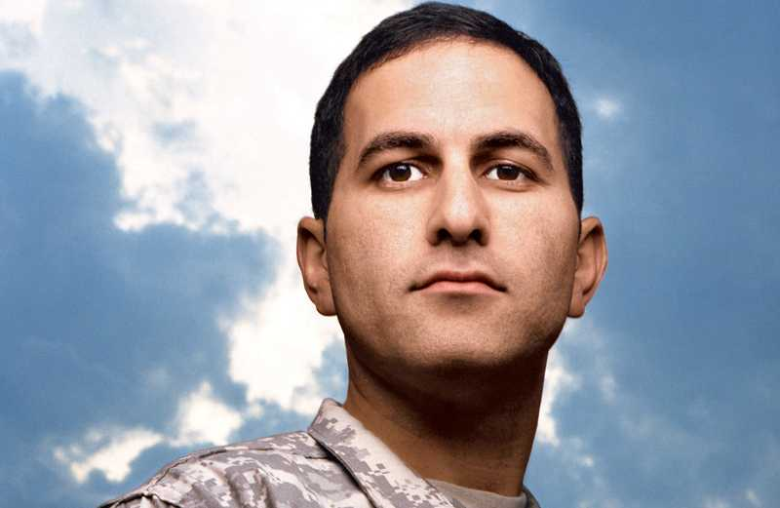
Notes:
Group Activity Approximately 30 minutes.
Instructor Notes: Use Student Handout for Scenario and Questions.
“ORSLC Chaplain Identity and Pastoral Care PE Student Handout”
Half of the room will be group A, half will be group B.
Have tables of 4 discuss the scenario and questions on the student handout for 15 minutes.
Then have each side of the room come together (all A groups together, all B groups together) to combine best ideas/practices for 10 minutes.
Have both groups present their work.
(Display slide 16)

Slide 16
References:
“Internal Family Systems,” Dr. Richard Schwartz
“There’s Part of Me,” Jon Schwartz
“When Hearts Become Flame,” Dr. Stephen Muse
“Becoming Who You Are,” James Martin
“Spiritual Direction,” Henri Nouwen
Notes:
Instructor Note: References listed were used for developing lesson as well as suggestions for personal development in this area.
(Display Slide 17)

Slide 17
Notes:
ASK: What are your questions?
Instructor note: See lesson plan page 16 for LSA 3 Check on Learning and Review Summary Statement.
Instructor Note: See lesson plan page 17 for TLO Check on Learning and Review/Summary Statement.

Slide 18
Terminal Learning objective
ACTION: Determine how developing chaplain identity informs pastoral care and supervision.
CONDITIONS: In a classroom, given access to regulations AR 165-1 and FM 1-05
STANDARD: Determine how developing chaplain identity informs pastoral care and supervision by: 1. Determining the correlation between chaplain identity and pastoral care 2. Comparing differences between company and field grade identity 3. Validating understanding of chaplain identity, pastoral care and supervision

