Slide 1
Defense Support of Civil Authorities (DSCA)
Operational Religious Support Leader’s Course
CH (COL) Geoff Bailey
Notes:
Welcome!

Slide 2
DSCA & UMTs
Terminal Learning Objective
Action: Understand UMT Involvement in DSCA
Condition: In a classroom, given a slide presentation and handouts.
Standard: Demonstrate cognitive understanding and theoretical delivery of religious support in DSCA.

Slide 3
DSCA & UMTs
Lesson Administration Information
Safety Requirements: Everyone is responsible
Risk Assessment Level: Low
Environmental Considerations: Recycle
Evaluation: Check on learning questions

Slide 4
DSCA & UMTs
ORSLC POI
DSCA and UMT Engagement
DSCA Overview

Slide 5
Practical Exercise
Pre-Instruction Check on Understanding
Scenarios

Slide 6
Agenda
References
What is DSCA?
Procedure
Roles and Responsibilities
Title X and 32
NGOs
What are they?
What do they do?
How do we work with them (Army)?
How do we work with them (Chaplains)?

Slide 7
References
ADP 3-28 Defense Support of Civil Authorities
ATP 3-28.1 MTTPs for DSCA
DoD Instructions 3025.18p Defense Support of Civil Authorities
JG 1-05 Religious Support in Joint Operations
JP 3-28 Defense Support of Civil Authorities
Guide to Nongovernmental Organizations for the Military
USAID Field Operations Guide for Disaster Assessment and Response
GTA 41-01-006 Working With the Office of U.S. Foreign Disaster Assistance
FEMA Website – www.fema.gov
USARNORTH CFLCC TACSOP – 15JUL13
Anecdotal Experience
Joplin Tornado Response, 2011
Mass Atrocity Response Operations Training, 2011
NORTHCOM RFF Mission 2013-2014

Slide 8
What is DSCA?
Defense Support of Civil Authorities
Defense support of civil authorities is defined as support provided by United States Federal military forces, DoD [Department of Defense] civilians, DoD contract personnel, DoD component assets, and National Guard forces (when the Secretary of Defense, in coordination with the Governors of the States, elects and requests to use those forces in title 32, United States Code, status) in response to requests for assistance from civil authorities for domestic emergencies, law enforcement support, and other domestic activities, or from qualifying entities for special events. Also known as civil support (DODD 3025.18).

Slide 9
Procedure?

Slide 10
Procedure?

Slide 11
Roles and Responsibilities?
Governor – Title 32 Authority
Incident Commander (Not pictured)
SCO – State Coordinating Officer
FCO – Federal Coordination Office
TAG – State Adjutant General (Senior USARNG official)
DoD
DHS
Governor
SCO
JTFHQ
FEMA
Mayor
TAG
LEOs
*
USARNG
FED Forces
NGOs
Local Businesses

Slide 12
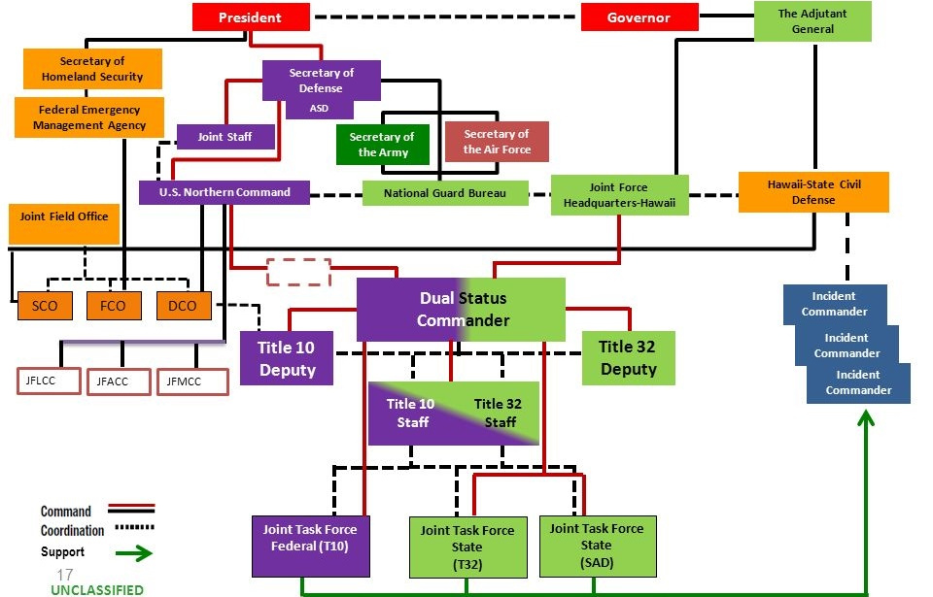
Typical Dual Status Commander

Slide 13
Guidelines for DSCA!
State and federal laws define how military forces support civil authorities
Civil authorities are in charge, and military forces support them
Military forces depart when civil authorities are able to continue without military support
Military forces must document costs of all direct and indirect support provided

Slide 14
Guidelines for Religious Support
USARNORTH JFLCC TACSOP – Chapter 13
The support must be individually and personally requested in an emergency situation, whereby the need is immediate, unusual, and unplanned.
The need must be acute. Acute needs are those which are of short duration, prone to rapid deterioration, and in need of urgent and immediate care.
The requested support must be incapable of being reasonably rendered by members of the clergy unaffiliated with the Armed Forces.
The support must be actually incidental. Such support incurs no incremental monetary cost and does not significantly detract from the primary role of the RST.

Slide 15
Title X and 32

Slide 16
Title X and 32

Slide 17
What is an NGO?
Nongovernmental organizations come in many forms, sizes, and types.
Many are religiously oriented, regionally based, technically specialized, or community-based organizations.
Humanitarian Aid
Emergency Response
Advocacy – Human Rights
Faith-based and religious in nature
Faith-based and not religious in nature

Slide 18
Examples of NGOs
American Red Cross // Red Crescent
Samaritan’s Purse
Salvation Army
Amnesty International
Soup Kitchens and Homeless Shelters
Americares
Project Hope
OXFAM
Doctors Without Borders
World Vision
Food for the Hungry
YMCA

Slide 19
What Do They Do?
Humanitarian Aid
Advocacy
Education
Disaster Relief
Community Development
State service Replacement

Slide 20
How Do We Work With Them?
Overlapping areas of responsibility
They are “free-agents” under no governmental obligation (local, state, or federal) in terms of “tasking”
Have incredible flexibility beyond ours due to decentralized organizational structure focused on care to the population
Two modes of operation can create conflict
Many government or military members retire and move to NGOs…which facilitates understanding
In some instances, NGO’s feel controlled by the military…need to work against this perception at times

Slide 21
How Do UMTs Work With Them?
At least 25% of NGOs in 2010 were faith based organizations
NGOs have been in some areas for years and know the communities from a grass-roots approach
UMTs might share a similar education or religious background, making it easier to talk with the NGOs
Soldier and Leader Engagements can help develop situational awareness for delivery of aid and understanding of challenges
Facilitate building trust with a hurting community

Slide 22
DSCA & UMTs
Terminal Learning Objective
Action: Understand UMT Involvement in DSCA
Condition: In a classroom, given a slide presentation and handouts.
Standard: Demonstrate cognitive understanding and theoretical delivery of religious support in DSCA.

Slide 23
DSCA & UMTs
Summary
Defined DSCA
Process for RFA
Guidelines for Religious Support
Working with NGOs

Slide 24
DSCA & UMTs
Closing
Knowledge and understanding of one’s operating environment is best developed prior to conduct of operations IOT provide effective religious support within the parameters provided.

