Slide 1
Design Religious Support Estimate
CH (MAJ) Mike DeRienzo
ORSLC Course Manager, USACHCS

Slide 2
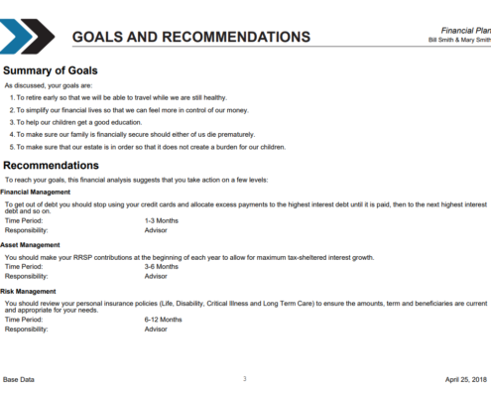
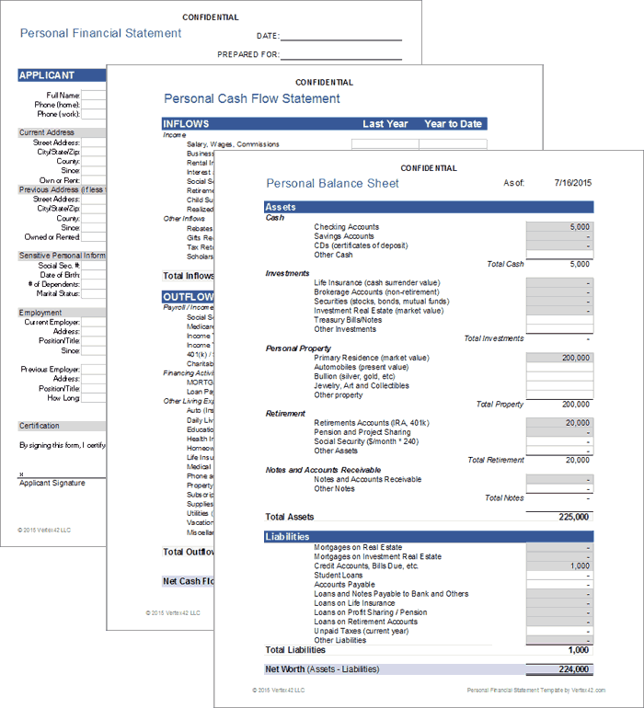
Notes:
(10 minutes)
Ask: What would you expect me to have prepared if I was your financial advisor?
Take responses
Say: Ultimately, you would want me to know and present information to answer any financial question you have.
In the same way, our planning and planning products do the same for our command and our UMTs.

Slide 3
Terminal Learning Objective (TLO)
ACTION: Design Religious Support Estimates
CONDITIONS: Given publications (JG 1-05, FM 1-05, FM 6-0, ATP 1-05.01) and a guided classroom discussion.
STANDARD: Demonstrate familiarity with Publications and produce a BDE level Religious Support Estimate.

Slide 4
Administrative Data
Safety Requirements: NONE
Risk Assessment: LOW
Environmental Considerations: NONE
Evaluation: NONE

Slide 5
Discussion
Why even bother planning religious support (RS)?
Notes:
(10 mins)
Dust Storm Example
Example of BCT Chaplain that says, “if you want the priest, come get him”.

Slide 6
Discussion
Where/how do we start planning RS?
Notes:
(10 mins; Slides 6-8)
After the students answer with RSE, then ask what is it and go to slide 7.

Slide 7
The running estimate
Running Estimate: A running estimate is the continuous assessment of the current situation used to determine if the current operation is proceeding according to the commander’s intent and if planned future operations are supportable (ADP 5-0).
A running estimate provides a timely, accurate evaluation of the unit, the enemy, and the AO at a given time (ATP 1-05.01).
Building and continuously maintaining running estimates is a primary task of each staff section (ATP 1-05.01).
Notes:
(10 mins)

Slide 8
The running estimate
Chaplains and religious affairs specialists use running estimates to facilitate situational understanding and support decision-making during planning, preparation, execution, and assessment activities (ATP 1-05.01).
An estimate should contain the information necessary to answer any RS question the commander poses (ATP 1-05.01).
Notes:
(10 mins)

Slide 9
DOCTRINE Familiarization
JG 1-05, Appendix A
FM 1-05, Chapter 4 (especially 4-9 thru 4-12)
FM 6-0, Chapter 8 and 9-19, 9-204
ATP 1-05.01 1-30 thru 1-42, 2-18 thru 2-25 and Appendix A
Notes:
(20 mins)

Slide 10
BREAK

Slide 11
Figure 1-1, ATP 1-05.01
Notes:
5 min
What about Garrison/rear ops?
Answer: Same Process

Slide 12
Group Activity
What goes into the Running Estimate?
When do you use it?
Notes:
30 minutes (15 minutes in group on butcher block paper, 15 minutes for 7 groups to share 2 min back brief)
NOTE: Collect Butcher Block Paper for data capture and incorporate into notes.
Each group gets a copy of:
FM 1-05, Chapter 4
FM 6-0, Chapter 8
ATP 1-05.01, 2-18 thru 2-25, Appendix A
Also: Blank quad charts from JRTC, generic BN estimate, 2 x Example of BDE UMT RSE
Answer to when: ALWAYS! INTEGRATE!
Provide: Religious Support Strategic Plan, Training guidance example

Slide 13
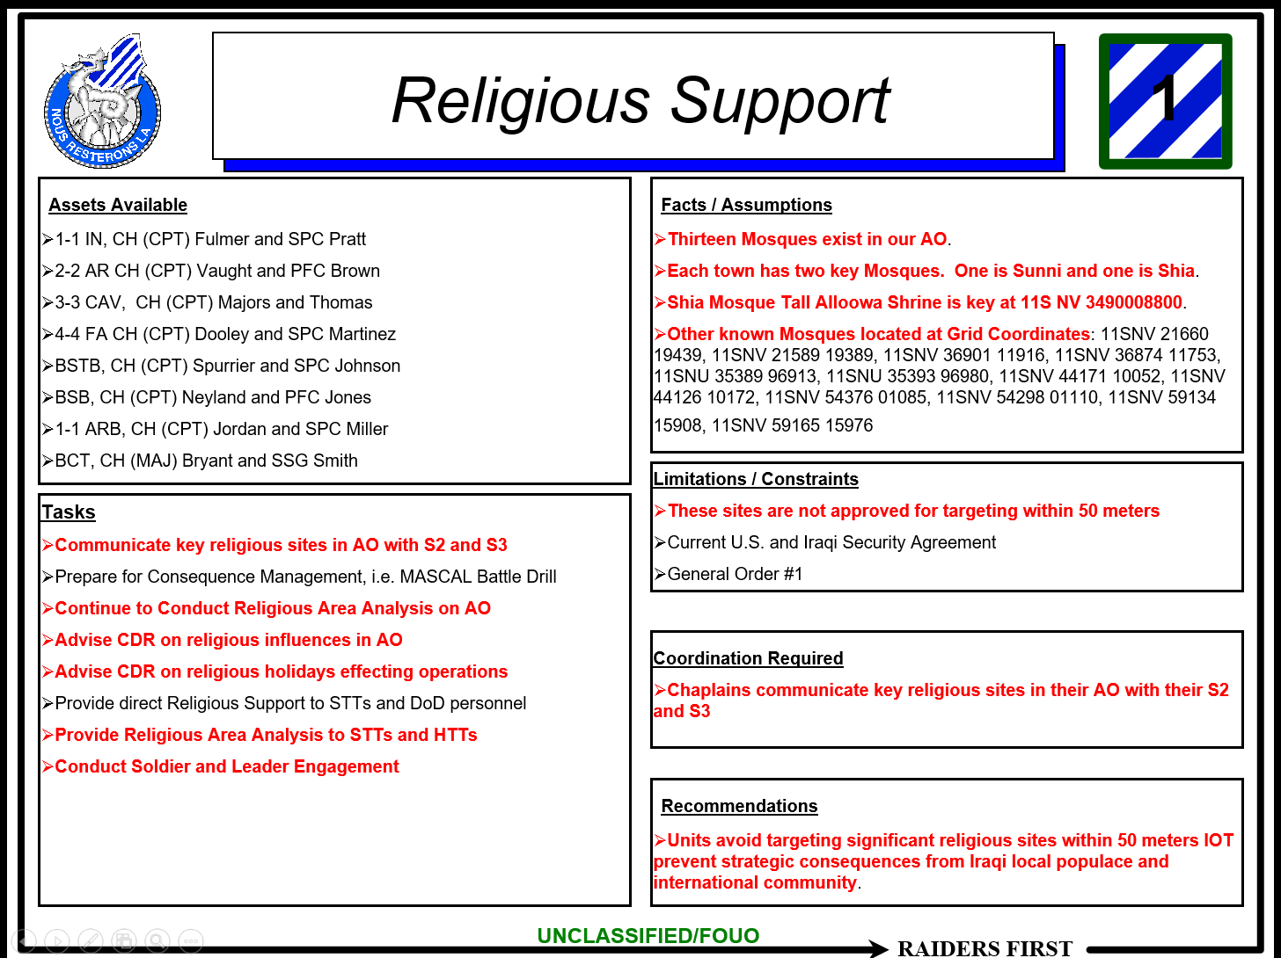
ExamplE

Slide 14
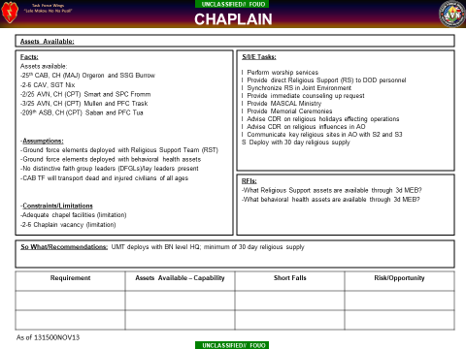
ExamplE
Notes:
RDSP

Slide 15
Discussion
What documents do you need to write your RSE?
Notes:
15 min

Slide 16
Discussion
What documents do you need to write your RSE?
BASE ORDER
DIV TAB D
DIV ESTIMATE PRODUCTS (2)
Notes:
Handout DIV products.
Take Questions

Slide 17
BREAK

Slide 18
Group Activity
Scenario: You are the the 1 CAV DIV RST Chaplain. Your 3CR Chaplain turns in the provided RSE. Improve your chaplain’s RSE.
Notes:
(30 min)
25 mins prep
5 mins share/compare
2 groups use RSE format from ATP 1-05.01
2 groups use RSE format from JRTC

Slide 19
Terminal Learning Objective (TLO)
ACTION: Design Religious Support Estimates
CONDITIONS: Given publications (JG 1-05, FM 1-05, FM 6-0, ATP 1-05.01) and a guided classroom discussion.
STANDARD: Demonstrate familiarity with Publications and produce a BDE level Religious Support Estimate.

