Slide 1
Indigenous Religions &
External Advisement
Operational Religious Support Leader Course

Slide 2
Brief Introductions
Name
Unit
Ecclesiastical Endorser/Faith Tradition

Slide 3
Terminal Learning Objective
Action: Establish the role of the operational-level chaplain in analyzing religion and culture throughout the Operational Environment.
Condition: In a classroom, given laptop computers with access to ATP 1-05.03
Standard: Establish the role of the operational-level chaplain in analyzing religion and culture throughout the Operational Environment by:
-designating ATP 1-05.03 as the Army’s primary doctrine for external advisement
-integrating awareness of one’s own biases into external advisement
-establishing the two categories of religion within the Operational Environment

Slide 4
Administrative data
Safety: None beyond those presented at the beginning of course.
Risk Level: Low.
Environmental: Recycle.
Evaluation: Check on Learning.

Slide 5
The chaplain’s Required Capabilities
U.S. Army Chaplain Corps
Required Capabilities
Core Competencies
Provide
Advise
Nurture
Internal
Care
External
Honor

Slide 6
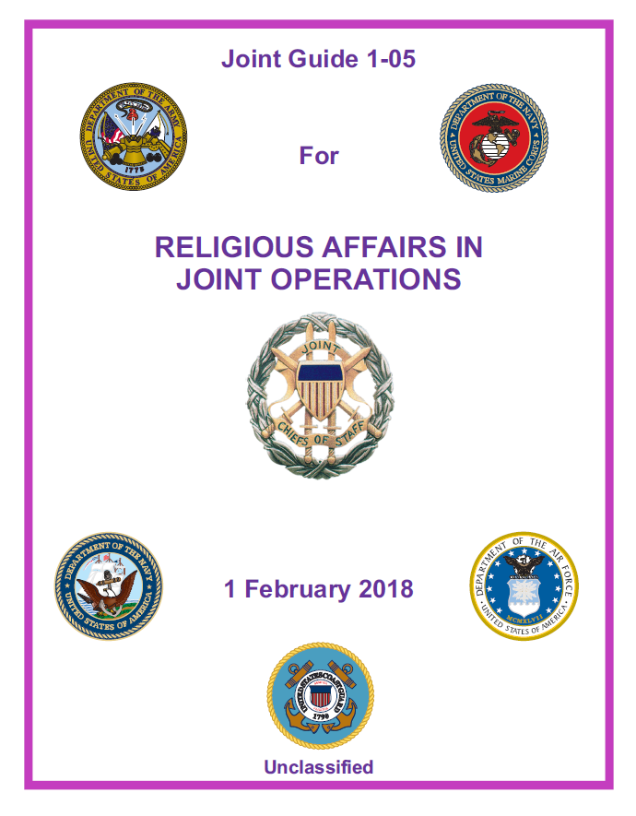
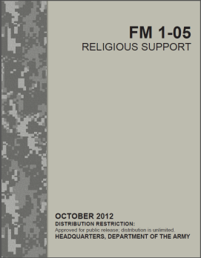
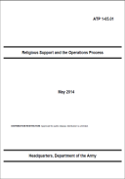
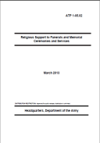
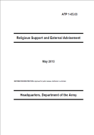
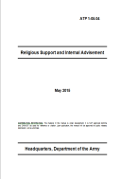
JG 1-05: Religious Affairs in Joint Operations (1 FEB 18)
FM 1-05: Religious Support
(21 JAN 19)
ATP 1-05.03: Religious Support and External Advisement
(31 JAN 19)
ATPs
Field
Manual

Slide 7
Contents of ATP 1-05.03 (31 January 2019)
Chapters
1 – Religious Support and External Advisement (overview)
2 – Religious Area Analysis
3 – Religious Impact Assessments
4 – Soldier and Leader Engagement
Appendices
A – Religious Factors in Analysis and Assessment
B – Religious Advisor & Soldier and Leader Engagement
C – Soldier and Leader Engagement and the Operations Process

Slide 8



Biases

Slide 9
Culture
The set of distinctive features of a society or group, including but not limited to values, beliefs, and norms, that ties together members of that society or group and that drives action and behavior.

Slide 10
Defining Religion When Advising the Command
Religion #1
Traditions & Beliefs
Practices & Observances
Texts
Sites
Religion #2
What “makes people tick”
Center of Gravity
Willing to live/die for
Comes from the source

Slide 11

Check on learning

Slide 12
Terminal Learning Objective
Action: Establish the role of the operational-level chaplain in analyzing religion and culture throughout the Operational Environment.
Condition: In a classroom, given laptop computers with access to ATP 1-05.03
Standard: Establish the role of the operational-level chaplain in analyzing religion and culture throughout the Operational Environment by:
-designating ATP 1-05.03 as the Army’s primary doctrine for external advisement
-integrating awareness of one’s own biases into external advisement
-establishing the two categories of religion within the Operational Environment

