Slide 1
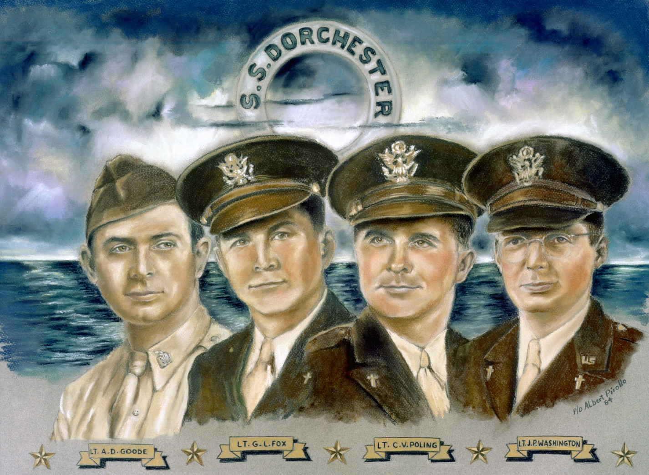
USACHCS 75th anniversary the FOUR chaplains
Shaping Servant Leaders
Of Unmatched Character, Competence, and Connection

