Slide 1
Assess Training Needs

Slide 2
Assess Training Needs (Cont.)
Direct Mission Essential Task List
Critical Task
Collective Task
Individual Task
Digital training Management System (DTMS)

Slide 3
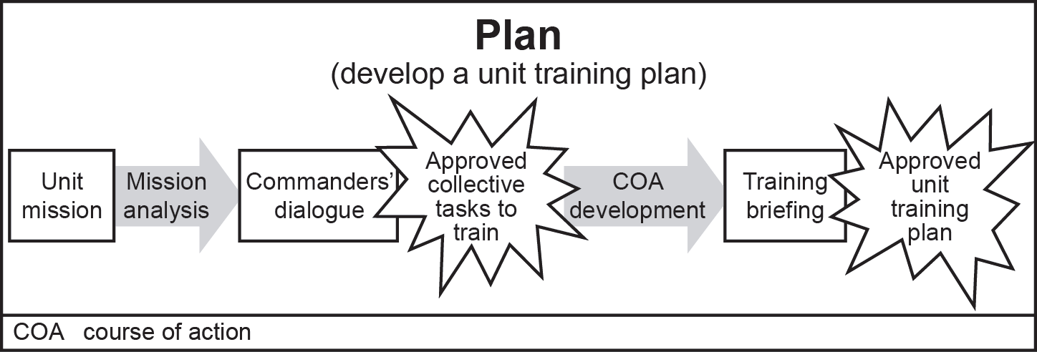
Develop a UMT Training Plan

Slide 4
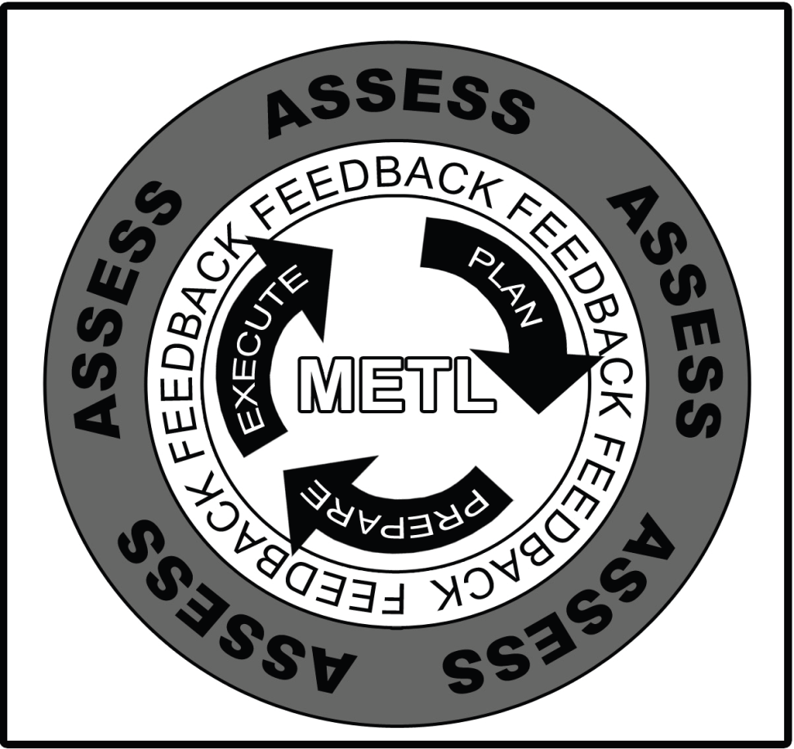
Manage a UMT Training Plan
Managing Training
Pre-Execution Checklist
Rehearsals
AAR’s
Training Evaluation
Outlines

