Slide 1
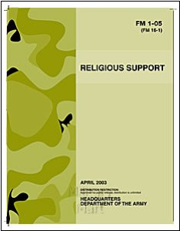
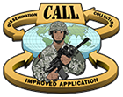
Cultural Resources
State Department Country Studies- http://www.state.gov/
TRADOC Culture Center
http://www.universityofmilitaryintelligence.us/tcc/cultural/default.asp
DLI Defense Language Institute - http://www.dliflc.edu/index.html
Center for Army Lessons’ Learned - http://usacac.army.mil/cac2/call/index.asp
USACHCS Library - upstairs
Center for World Religion - downstairs
Unit S-2, S-5, or Cultural Advisor – at your unit
Univ. of Military Ministry (UMM) portal –
https://www.tkeportal.army.mil/sites/umilmin/default.aspx
National Defense University (NDU) portal- http://www.ndu.edu/
Brookings Institute Saban Center- http://www.brookings.edu/saban.aspx

