Slide 1
Four-Dimensional Conditioning Tasks
Somatic (body)
Perform Deep, Focused Breathing 2x day
Perform a Body Scan
Practice Mindfulness
Sleep 7 hours Uninterrupted
Maintain Good Hydration & Diet; Eat at regular times
Reduce sugar, caffeine, alcohol, and nicotine
Exercise 3 to 5 days minimum
Maintain Cleanliness Daily
Exfoliate the Body (brush or salt)
Receive Therapeutic Massage
Affective (emotions)
Practice Mindfulness
Notice Your Visceral Response
Identify the Surface and Deeper Emotion (Use the ‘Wheel’)
Speak or Write the Emotion: “I feel ____”; Get It Out
Share It with a Trusted Person
Use the X-Y-Z Formula:
(situation-action-emotion)
“today you did__, I felt__.”
Express Emotion Through Art
Express It Through Journaling
Give It to God (Psalm of Lament)
Cognitive (mind)
Practice Meditation
Practice Visualization
Perform Journaling
Practice Times of Silence
Practice Times of Solitude
Share Your Ideas with Others
Perform Personal Reading
Practice Mindfulness
Keep a Dream Journal and Try to Understand Dreams
Practice Thought ‘Capturing’
Share the Meaning of Events with a Trusted Other; Be Open to Other Meanings
Spiritual (connections)
Maintain Strong Connections with Family and Friends
Talk with God (prayer)
Talk with a ‘Confessor’ (Trusted Counselor / Mentor)
Read Sacred Texts
Find Meaning & Growth in Life
Worship with Others Regularly
Maintain Openness and Curiosity
Forgive Self and Others
Accept the Past; Use It for Good
Stay Focused on the Moment
Practice Contemplation
Practice Centering Prayer
4/3 IBCT UNIT MINISTRY TEAM
ANTIFRAGILITY TRAINING
912-435-7657

Slide 2
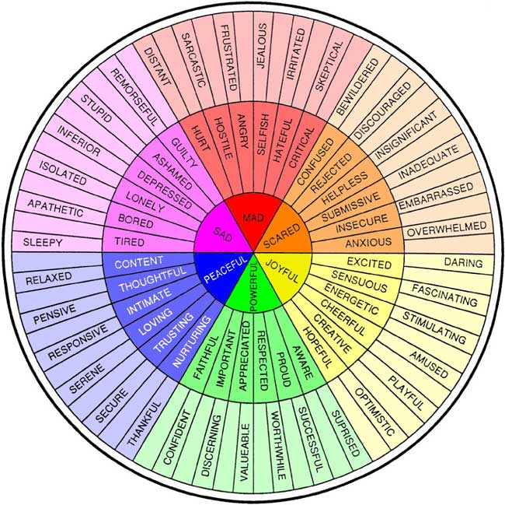
Use the Emotion Wheel
MAD
SAD
SCARED
JOYFUL
POWERFUL
Identify the emotion in the center that best describes your primary or surface feeling. Move outward until you identify the deeper or secondary feeling beneath the surface feeling (e.g. you feel mad because you’re jealous).

Slide 3
Body
On Mindful Body Scan
What: becoming aware of the sensory input of your nervous system
How:
Close eyes, take two to three deep breaths
Become very still and remain still
Focus attention on your body, slowly, from toe to head
Become aware of sensations: the feeling of your feet touching the ground, your back against the chair, any comfort or discomfort, any pain, any tension. Acknowledge without moving.

Slide 4
Mind
On Meditation:
What: Concentrated, mindful thinking on anything
How:
Slow down, read three times
Focus on each word, one at a time, as you read again
What stands out and how do you feel?
Sample:
“timidity will do a thousand times more damage than audacity” - Carl von Clausewitz
“There is no fear in love. But perfect love drives out fear” 1 John 4:18

Slide 5
Emotion
On handling emotion
What: The X-Y-Z formula for communicating emotions
How:
“When in situation X, you said or did Y, and I felt Z”
Sample:
“This morning at PT, when you thanked me for the help with the inspection, I felt appreciated”
“Yesterday at diner, when you compared my cooking to your mother’s in front of the family, I felt embarrassed and hurt.”

Slide 6
Connection
On forgiveness
What: not holding offense (bitterness, anger, frustration) against self or another; refusing to punish or demand repayment.
Why: unforgiveness destroys you
How:
Acknowledge the pain of the offense (at least to self) using X-Y-Z
Make a choice to no longer hold the offense against self or the other
Communicate (at least to self) forgiveness
Daily remind self you have chosen to let it go
Don’t bring it up when tempted

